Slide 1
Medieval teens & Black death
Department of Archaeology

Slide 2
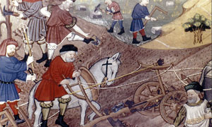
Being a TEEN in Medieval Times
Would you go to school?
Would you be able to read and write?
What age would you start working?
What jobs would you do?
Where and with who would you live?
https://www.youtube.com/watch?v=7qu5r-6KGBI

Slide 3
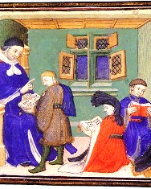
Being a TEEN in Medieval Times
Little formal education especially if you were a girl
Started working before 15 years of age, especially in the countryside

Slide 4
Village work
Most jobs were in agriculture, such as weeding, fruit pick and feeding animals

Slide 5
Village work
Girls might work as servants in the houses of other families and help looking after young children

Slide 6
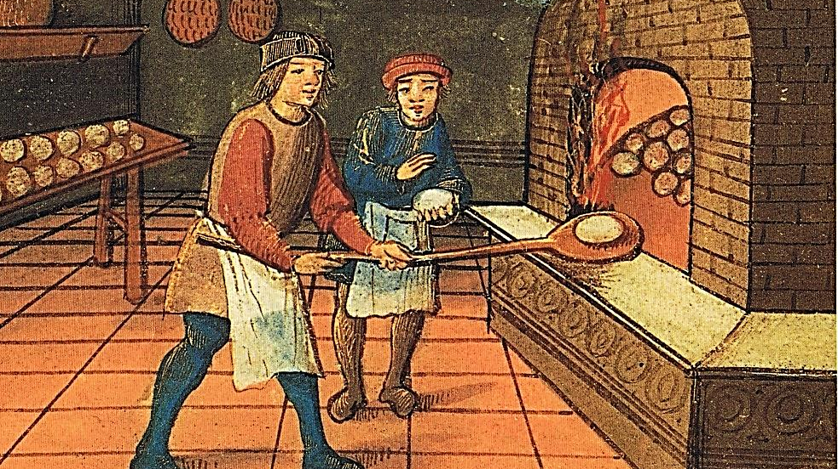
Town work & apprenticeships
Commonly boys would get an apprenticeship which lasted around 7 years. They would live with their masters and be taught the needed skills.

Slide 7
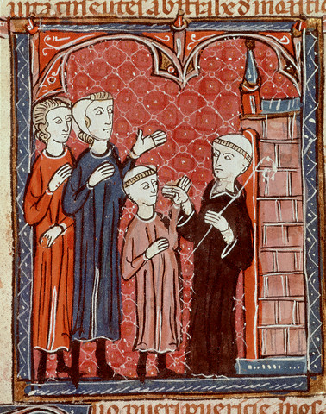
Town work & apprenticeships
The children of better off families went out to work in order to save money and learn trade skills
Children who could not afford apprenticeships moved away from their families to start work as labourers or servants

Slide 8
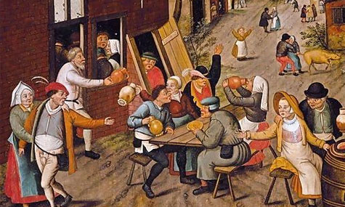
Medieval life –the game
Pick a card
Each card has your current situation at the age of 12-13 and the life choices you face a this point
Read the card and choose one of your options
Think carefully about the consequences of your choice
Extra information to make up your mind

Slide 9
Medieval life – Things to consider
FARMS: physically demanding; stay with your family
SERVANTS: physically demanding; new house, new family
APPRENTICESHIPS: lots of responsibility; very strict rules
TOWNS: better pay; more jobs; easier to contract diseases
LOOKING FOR WORK: starve if you cannot find a job

Slide 10
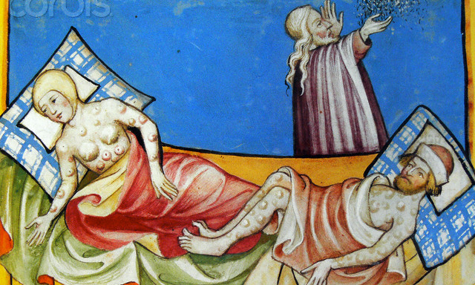
Black death – who perished?
In AD1348 the bubonic plague arrived in England
Spread by fleas that fed on blood of infected rats
Fever, headaches and boils in the armpits, neck & groin
At least one third of the population died, especially poor people who have moved into the towns

Slide 11
Black death – the after life
What happened to the survivors? Are they better or worse off than before?

Slide 12
Black death – consequences
Fewer jobs: wages increased
Empty houses: cheaper rents
Food price: decreased (more land for crops)
Older sibling’s death: inherit land, businesses and money
Better marriages

