Slide 1
Julia Tertia - The ivory bangle lady

Slide 2
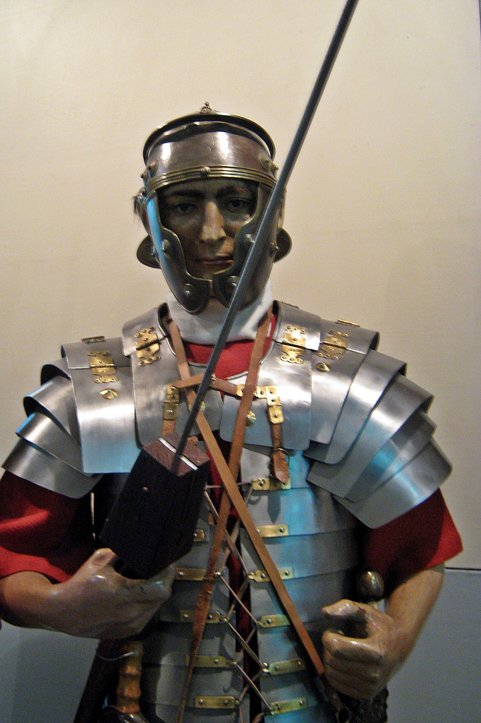
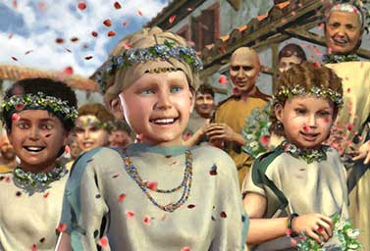
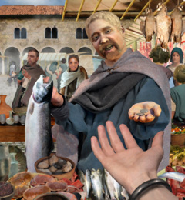
Who were the romans?
What do you think the Romans looked like?
©Christian Peter Marinescu-Ivan

Slide 3
Grave of the ivory bangle lady
IN YORK, A ROMAN GRAVE WAS FOUND WITH THE SKELETON OF A WOMAN AND EXPENSIVE GRAVE GOODS.

Slide 4
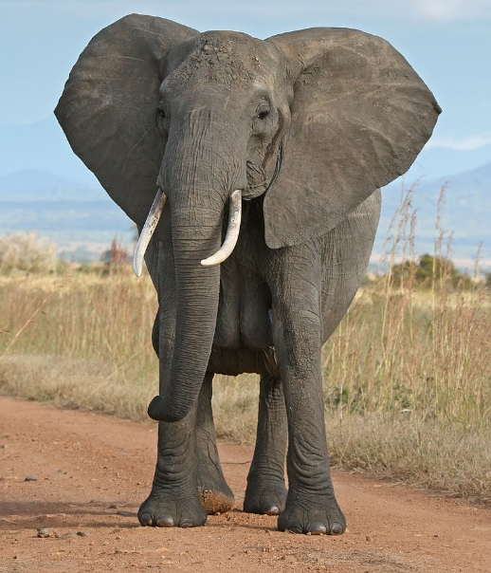
The grave goods
The ivory bracelets are high status objects. The ivory comes from north Africa and it probably was worked somewhere like north Italy and shipped to Britain.
©Muhammad Mahdi Karim

Slide 5
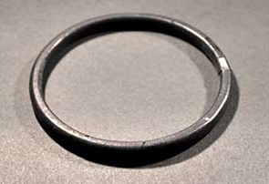
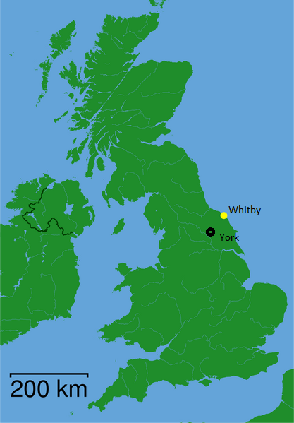
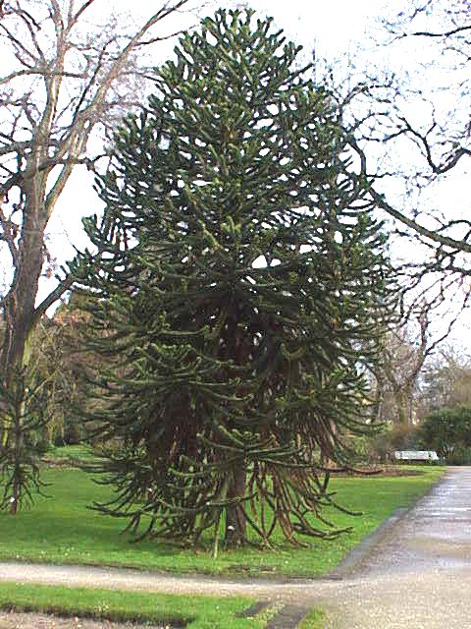
The grave goods
Jet bracelets are a local product. Jet occurs naturally in Yorkshire in the area of Whitby.
These could have been sold in the market at York.
©GFDL by Kurt Stueber
From: CC BY-SA 3.0 via Wikimedia Commons

Slide 6
The grave goods
Glass bracelet with blue beads.

Slide 7
THE GRAVE GOODS
This is a beautiful blue glass jug which is quite precious. It would have, perhaps, been used for perfume or wine.

Slide 8
The grave goods
The Romans did have mirrors made of glass. The mirror probably had a leather or wooden case which has not survived. What this might tell us is that she was quite concerned with her appearance.

Slide 9
The grave goods
A really strange and unusual object that was also found in this grave is a tiny inscription made from bone. The inscription says, 'Hail Sister, may you live in God'. That is a Christian blessing so maybe this woman was a Christian.

Slide 10
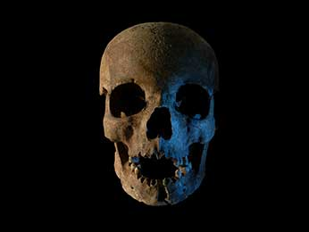
THE SKELETON
Scientists found that the skeleton was from a young woman. She was healthy and her teeth were in very good condition.
We can listen to the scientist who studied her here.

Slide 11
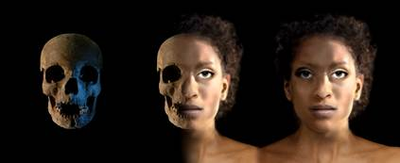
The skeleton
The details of some bones in her skull suggest that one of her parents may have been from north Africa.

Slide 12
The skeleton
Teeth are formed during childhood and take up some of the elements from the water and food we consume.
Chemical analysis of her teeth shows that she may have grown up somewhere slightly warmer than Britain.

Slide 13
The story of Julia tertia
High status woman of North African descent.
Moved to York from somewhere slightly warmer.
How do you imagine Julia’s life?
You can read and listen to Julia’s story here.

Slide 14
What this story tells us
Who were the Romans in Britain?
Wealthy people from all over the Empire settled in Britain.
Julia’s high status tells us about the lives of African Romans.

