Slide 1
BASIC INFO FOR TRAINING. DSC Q2000.
Extracted from the ppt TA DSCQSeminar

Slide 2
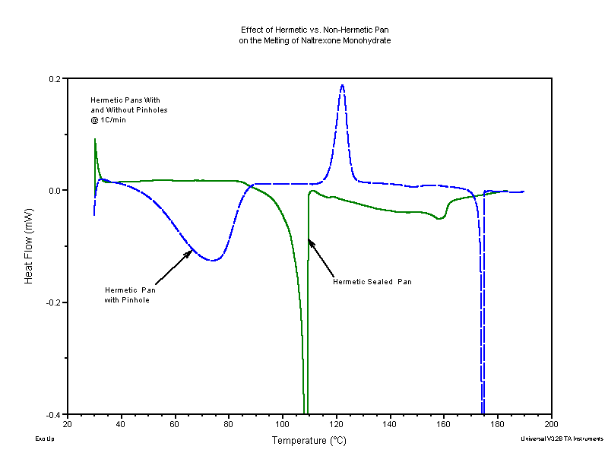
It Does Matter What Pan you use
Monohydrate Pharmaceutical sample
Notes:
Green curve is hermetic sealed pan, while blue curve is vented pan. Sealed pan shows crystalline melt, while vented shows loss of H2O. Sample is a channel hydrate and loss of water causes collapse of crystalline structure to amorphous.

Slide 3
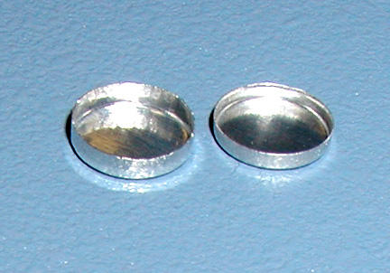
Sample Shape
Keep sample thin
Cover as much as the bottom of pan as possible

Slide 4
Sample Shape
Cut sample to make thin, don’t crush
If pellet, cut cross section

Slide 5
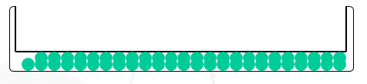
Sample Shape
Cut sample to make thin, don’t crush
If pellet, cut cross section
If powder, spread evenly over the bottom of the pan

Slide 6
Sample Size
Larger samples will increase sensitivity
        but…………….
Larger samples will decrease resolution
Goal is to have heat flow of 0.1-10mW going through a transition

Slide 7
Sample Size
Sample size depends on what you are measuring
  If running an extremely reactive sample (like an explosive) run very small samples (<1mg)
  Pure organic materials, pharmaceuticals (1-5mg)
  Polymers - ~10mg
  Composites – 15-20mg

Slide 8
Effect of Sample Size on Indium Melt

Slide 9
Agenda
Keeping your DSC cell clean
Calibration
Sample Preparation
Thermal Method

Slide 10
Purge Gas
Purge gas should always be used during DSC experiments
  Provides dry,inert atmosphere
  Ensures even heating
  Helps sweep away any off gases that might be released
Nitrogen
  Most common
  Increases Sensitivity
  Typical flow rate of 50ml/min

Slide 11
Sample Temperature Range
Rule of Thumb
  Have 2-3 minutes of baseline before and after transitions of interest - if possible
    DO NOT DECOMPOSE SAMPLES IN DSC CELL
  Temperature range can affect choice of pans
  Just because the instrument has a temperature range of –90°C to 550°C (with RCS) doesn’t mean you need to heat every sample to 550°!

Slide 12
Start-up Hook

Slide 13
Heating Rate
Faster heating rates increase sensitivity
  but…………….
Faster heating rates decrease resolution
Good starting point is 10°C/min

Slide 14
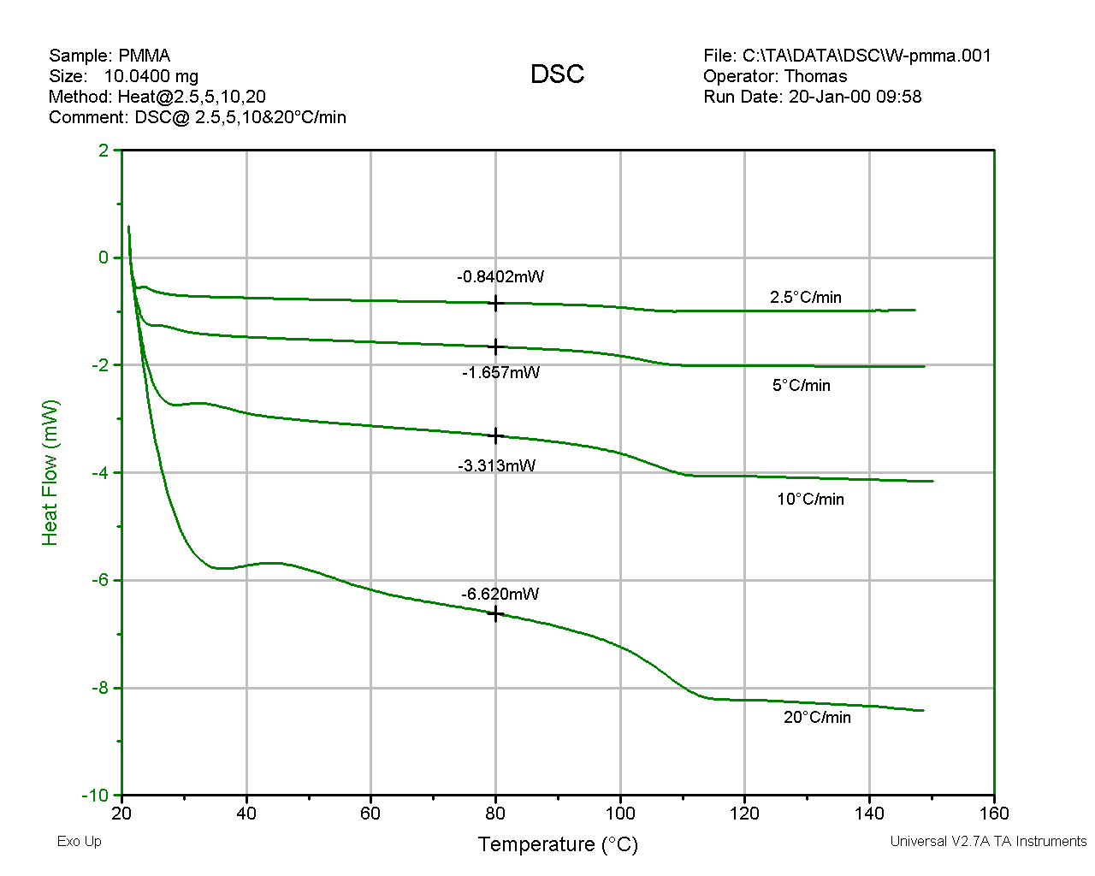
Effect of Heating Rate
PMMA 10.04mg

Slide 15
Thermal History
The thermal history of a sample can and will affect the results
The cooling rate that the sample undergoes can affect :
  Crystallinity of semi-crystalline materials
  Enthalpic recovery at the glass transition
Run Heat-Cool Heat experiments to see effect of & eliminate thermal history
  Heat at 10°C/min
  Cool at 10°C/min
  Heat at 10°C/min

