Slide 1

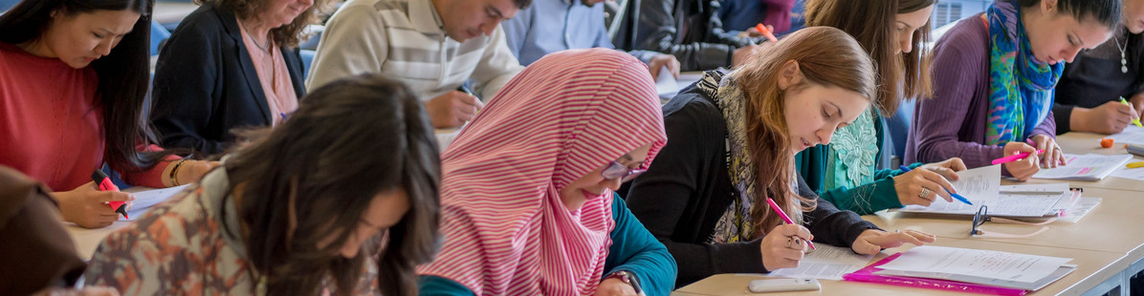
Race Equality at Reading:
2018-2021 Action Plan Launch
Deans for Diversity and Inclusion
Ellie Highwood
Dean for Diversity and Inclusion
www.reading.ac.uk/diversity
Notes:
First Diversity and Inclusion themed leadership development session.
Focus is on Gender charter mark, the Athena SWAN scheme
We are reapplying to renew our Institutional Bronze level award in April 2016 – today we want to bring you up to date with progress, involve you in defining our future action plan, and explain how the Charter Mark is changing to include AHSSBL as well as STEMM subjects.

Slide 2
Why is the University committed to D&I
Fairness – it’s the right thing to do
Reduced risk of reputational damage
Enhanced business decisions: diverse and inclusive boards and committees make better decisions
Benefits to all from better (fair, accessible and transparent) processes
Access to research funding (particularly in key Health research theme)
Improved attainment and achievement leading to increased employability of graduates
It’s the Law!
Equality Act
2010
Increased likelihood of attracting and retaining excellent students and staff
Notes:
There are a number of reasons why Reading needs an emphasis on D&I. It is central to several parts of the 2026 vision: a global university, educating for the 21st century and influencing policy and practice, thriving community.
Specifically, experience of D&I work both here at School level and in the wider world suggests D&I emphasis delivers:
Enhanced business decisions – lots of evidence here that diverse boards make more profitable decisions. Research including from our own HBS that 30% is a minimum level for minorities to have a voice. – hence the 30% club
Access to research funding: especially crucial for SCFP who recently had to pull out of a £70M NIH bid as they did not get a silver Athena SWAN award from Equality Challenge Unit, but also PCLS and SBS
Increased likelihood of attracting and retaining the best students and staff – increasing competition
Improved attainment and achievement leading to increased employability of graduates
Likely positive impact on TEF rating, although details still unclear
Benefits to ALL staff from fair accessible and transparent processes, additional development opportunities through networks and events
Reduced risk of reputational damage – e.g. via student actions experienced here and elsewhere or academic scandals as seen at several institutions in the US in the past year.

Slide 3
The Law: Equality Act 2010
Has additional requirements for public sector organisations, including universities, to:
Eliminate unlawful discrimination, harassment and victimisation and other conduct prohibited by the Act.
Advance equality of opportunity between people who share a protected characteristic and those who do not.
Foster good relations between people who share a protected characteristic and those who do not.

Slide 4
WHY?

Slide 5
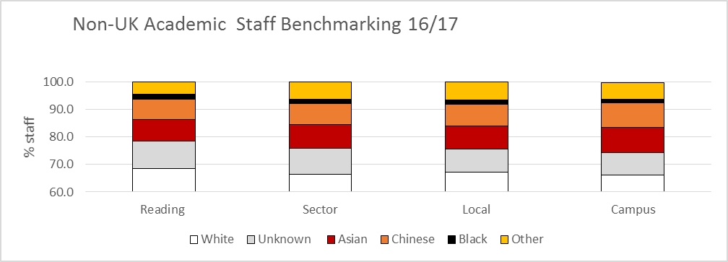
Race At Reading – Academic Staff

Slide 6
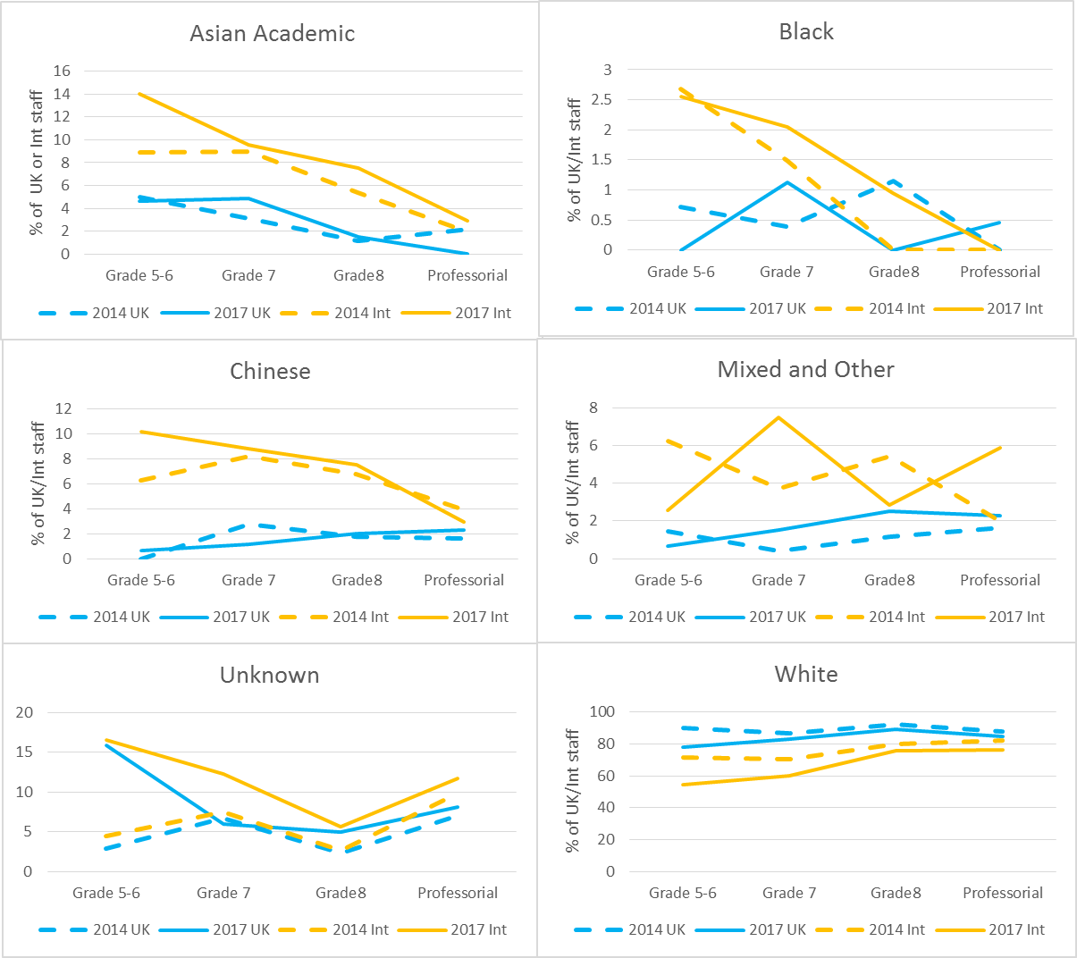

Slide 7
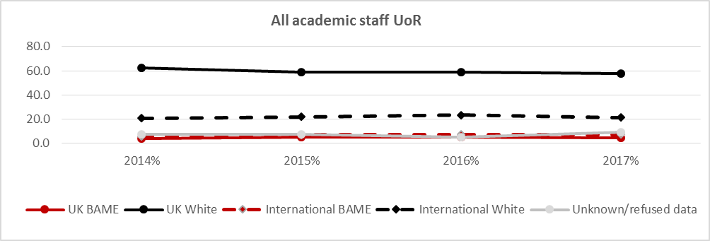
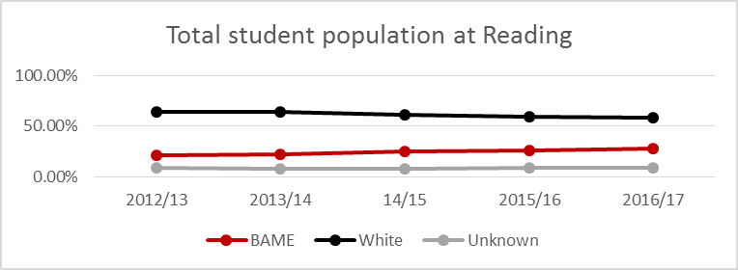
Increasingly Out Of Sync With Students

Slide 8
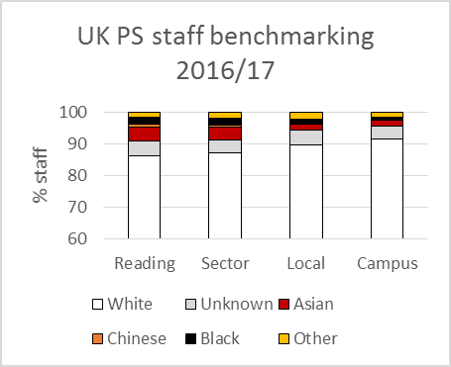
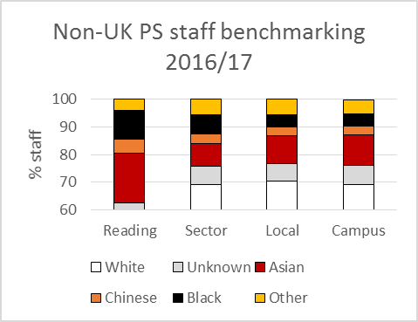
Race At Reading – Professional Services

Slide 9
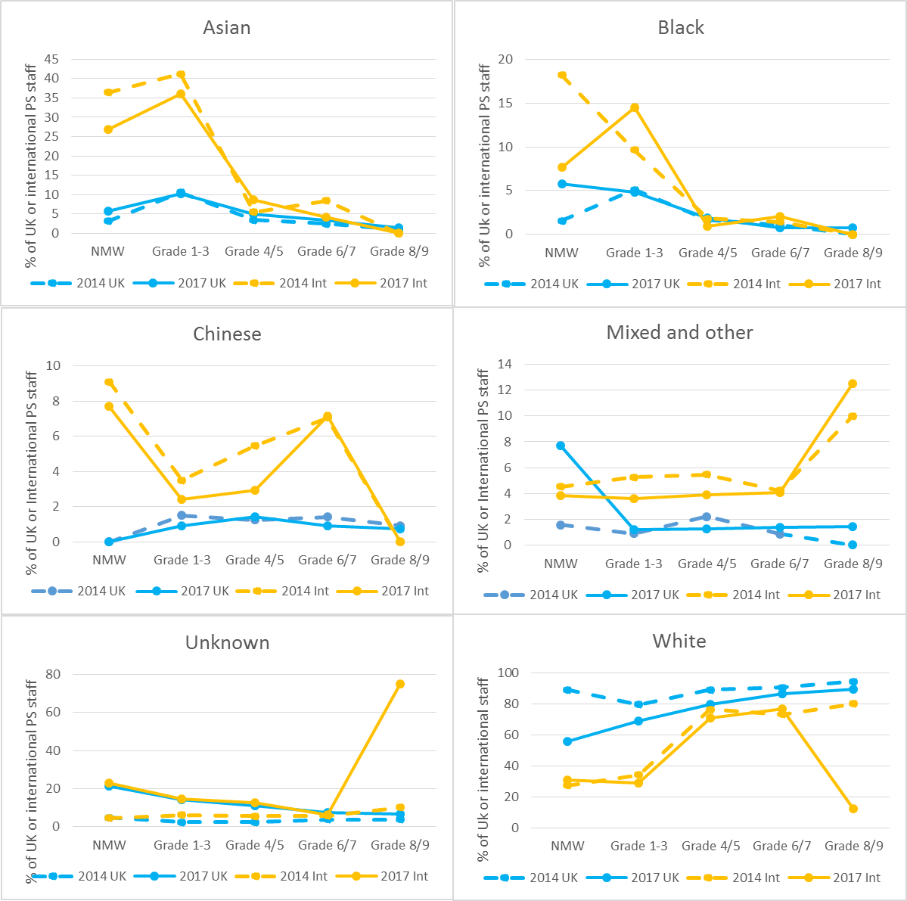
BAME G1-3 ~ 18%
BAME G6+ ~7%

Slide 10
Out Of Sync With Local Population
BAME 25.2%

Slide 11
Ethnicity pay gap
Mean salary pay gap is 19.8% (1 Jan 2017)
Within grade pay gap Grades 1-8 is less than 3%
Gap comes largely from occupational segregation as seen previously
Lump sums are lower
BAME staff are under-represented in lump sum and celebrating success vouchers.

Slide 12
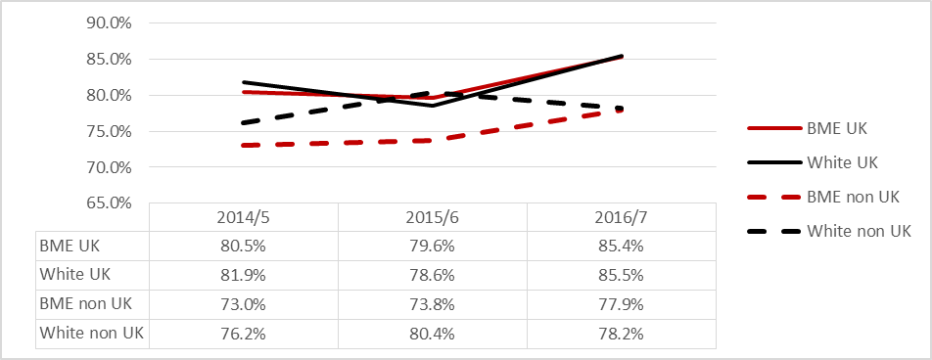
Race At Reading - Students
UG Application success
Faculty | 2014/5 |  | 2015/6 |  | 2016/7
 | No. | % | No. | % | No. | %
AHSS | 864 | 22% | 1014 | 24% | 1226 | 27%
HBS | 462 | 28% | 625 | 30% | 872 | 34%
LS | 801 | 28% | 874 | 29% | 1001 | 31%
SC | 339 | 20% | 397 | 21% | 484 | 24%
UG BAME student body by “faculty”

Slide 13
Ethnicity Attainment Gap 2.1/1sts

Slide 14
Experiences matter…
31% of minority staff disagree that the “University recognises and celebrates the diversity of ethnicities and culture on campus” (compared to 9% majority staff
18% of minority staff and 28% of minority students have witnessed or been the victim of racial harassment on campus (but only 7% of staff and 2% of students have reported it)
71% of male minority students are confident action would be taken, but ony 41% of female minority students
Only 48% of minority students believe UoR communicates that racially offensive behaviour is unacceptable in halls
Staff focus groups and interviews (conducted by TMP) suggest some minority staff feel there is a ceiling to their progression at Reading
23% of minority staff and 30% of minority students have been a witness of victim of racial discrimination in the local area

Slide 15
What?

Slide 16
UoR Targets- Set In 2016
Metric | 2020 | 2026
Staff related
BAME representation on Key University Committees (definition) | To match academic staff representation by 2020 (14%) and keep pace thereafter
Council and its sub-committees diversity | To set targets for BAME representation on their committees consistent with national census baseline for BAME
Increased BAME representation across non-academic staff body | A minimum of 15% in each of grades 1-5 non-academic staff and 12% in grades 6-9 non-academic staff to be BAME by 2020. (levels set by 2011 local and national census data respectively to reflect likely recruitment) | 16% in each of 1-5 and grades 6-9 overall
Increased BAME representation amongst academic staff | A minimum of 14% of academic staff in grades 7 and above to be BAME by 2020. (Higher than national census data due to large number of International academics) | 18%
University Leadership Roles (HoS/HoF/UEB) |  | 18% (matching staff percentage) and recognising that this will take longer to achieve.
Student related
Reduction of the attainment gap (proportion of first and upper second class degrees achieved) between BAME and white undergraduate students | Reduction from 16.5 percentage points (2014/15) to 12 percentage points | < 10 percentage points gap
Reduction of the postgraduate BAME student failure rate | From 6% (2014/15) to 4% | Parity (c. 3.5%)

Slide 17
How?

Slide 18
Race Equality Action (RE-Act)
2018-2021 Action Plan
11 themes drawn from quantitative and qualitative data
  Understanding and celebrating race and ethnicity
  Report and Support processes
  Zero tolerance messages
  Attracting and retaining diverse staff talent
  BAME staff progression and development
  Ethnicity differentials in reward and recognition
  Improving BAME student attainment and progression
  Creating diverse and relevant curricula
  Building links with the local Community
  Intersectionality

Slide 19
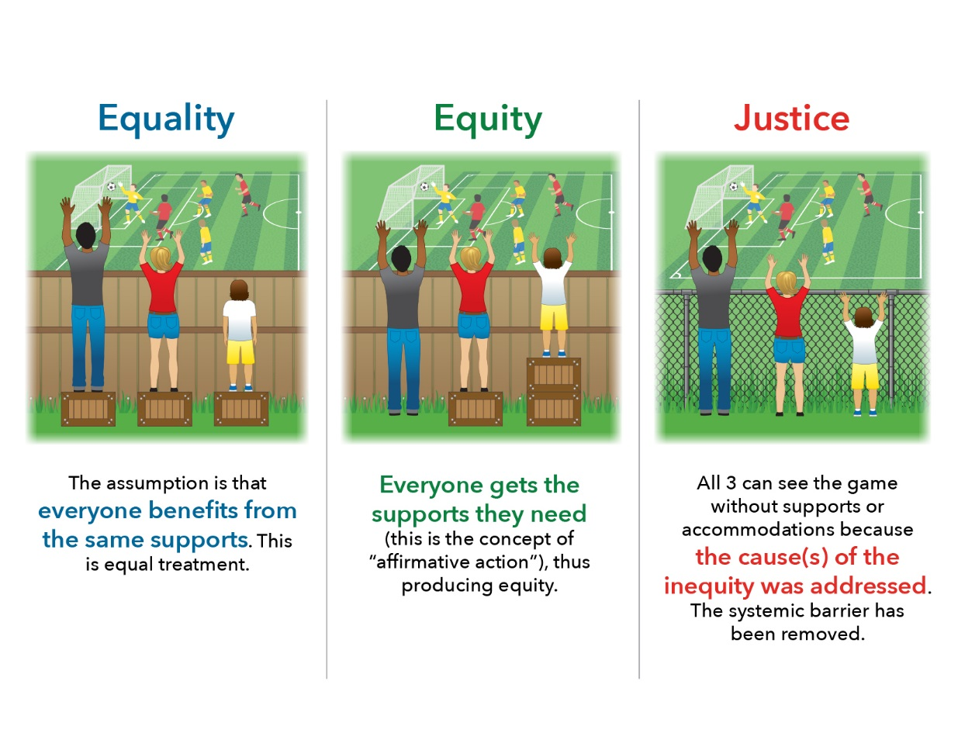

Slide 20

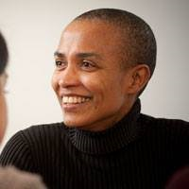

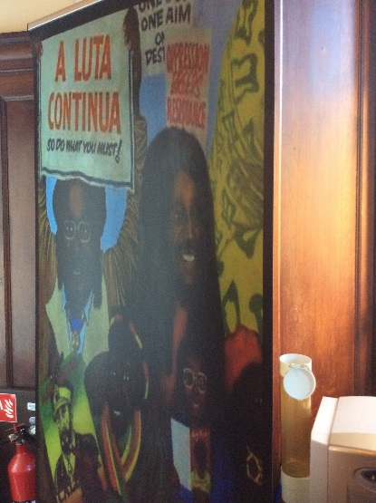


1. Understanding And Celebrating
Race And Ethnicity at Reading
Annual programme of events across the University, some centre led, others from Schools or functions, in association with RUSU.

Slide 21

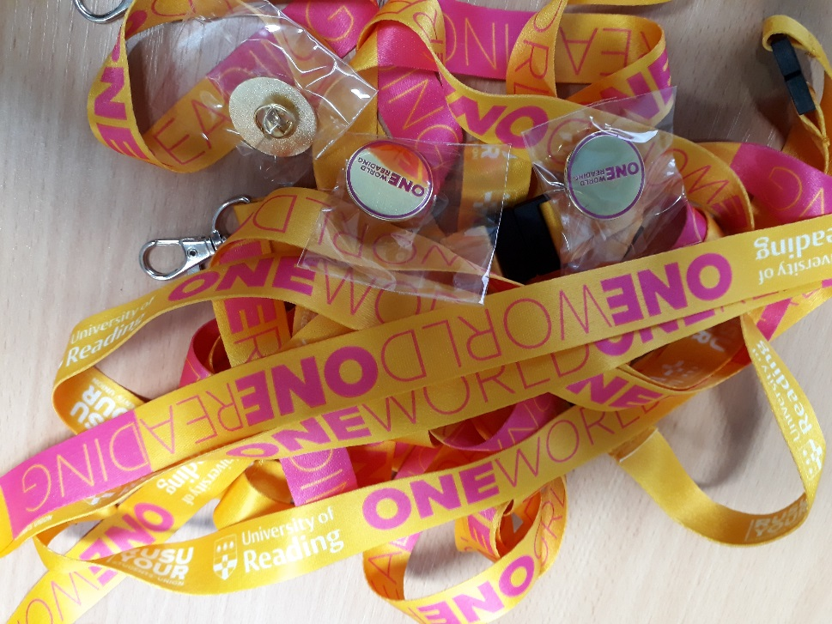
2&3 Support And Report /
Zero Tolerance Message

Slide 22
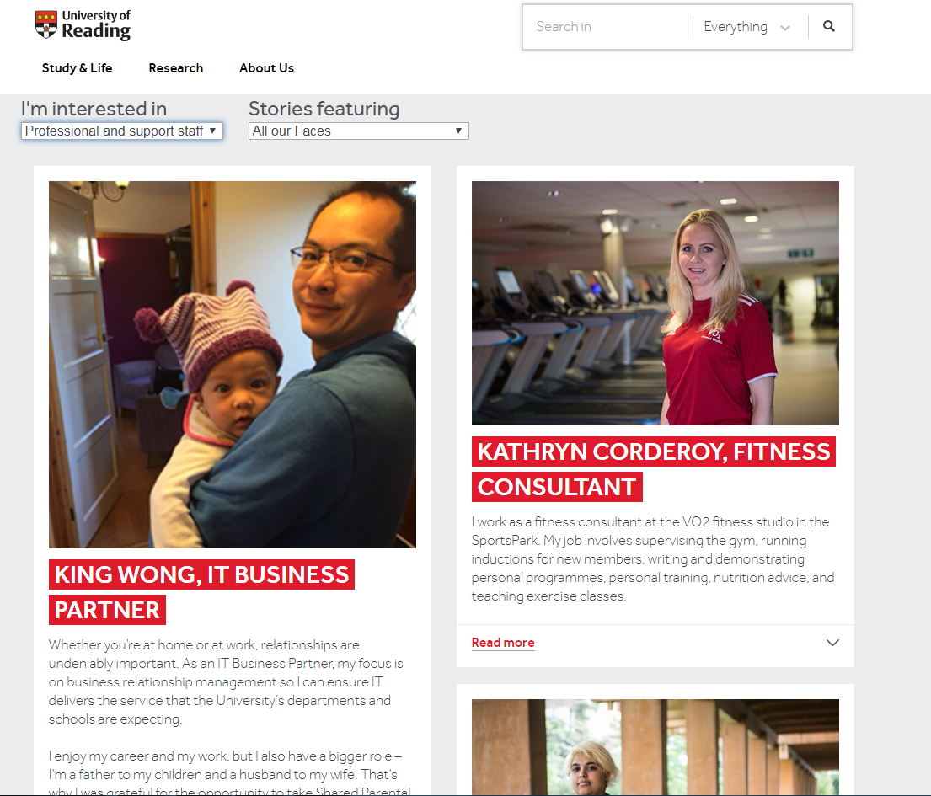
4. Attracting And Retaining
Diverse Staff Talent
Anonymised shortlisting trial
Enhanced guidance for chairs of recruitment and selection panels
Exit interviews
RISE@Reading (Ready for Inclusive Leadership at Reading
Advertising in different places
www.reading.ac.uk/faces

Slide 23
5&6. BAME Staff Progression
And Development / reducing pay differentials
Working to understand different success rate in academic promotions
Better quality data on ethnicity differences in experience of and access to training on offer

Slide 24


7. Improving BAME Student
Attainment And Progression
Study
Smart
Thrive career mentoring
Academic Tutor System
Peer Assisted Learning (PAL)
SESTEM study on experiences of minority ethnicity students in STEM subjects (Billy Wong, IoE)
Diversify student services front-line staff – “sense of belonging”, relatedness
Develop support for commuter students and BTEC students
Learning analytics and improved metrics to allow identification of students who are struggling or disengaging with study
Teaching staff development
Working with home white students on identity and race, and language

Slide 25
8. Creating Diverse Curricula
….designed to meet the needs and be representative of the world we live in, recognising the contributions made by different genders, cultures, races and the perspectives of/impact on different groups…
….not limited by the scholarly perspective of one culture or country; rather, it is defined by the opportunities it gives students to consider global perspectives on their subject and its application, and to develop intercultural competence.
Embedding cultural competency training for staff and students
Review progress on ethnicity dimensions of programme review
Showcase of good practice, spring 2019

Slide 26
9. Linking With Local Communities
Start a local discussion forum with e.g. Reading Borough Council, Oracle, NHS, Fire service and other organisations to share understanding and host events. Boost mentoring opportunities for students via this network
10. Thinking About Intersectionality
Extend provision for faith support as diversity of religious belief rises amongst students, in particular introduce a voluntary Muslim chaplain role.
Extend Diversity data dashboards to allow analysis by sex AND race (in recognition of big differentials in experience/attainment for female students of colour)

Slide 27


Getting Involved
Organisation has responsibility, but organisations are made up of individuals.

Slide 28

Put On Your Race Equality Lenses
Help the RE-ACT Team
Join the Cultural Diversity Group
SBTL meetings, admissions, open days.
5 Year Plans
Curriculum Framework
Reflection and actions in your area including
  Your own experiences of race, including recognition of white privilege (RISE@Reading might be one way to be supported to do this. Also read White Fragility by Robin D’Angelo)
  Recruitment and selection
  Teaching content
  Assessment type
  Group work
  Discussion of identity as part of programme (to facilitate group work?)

