Slide 1
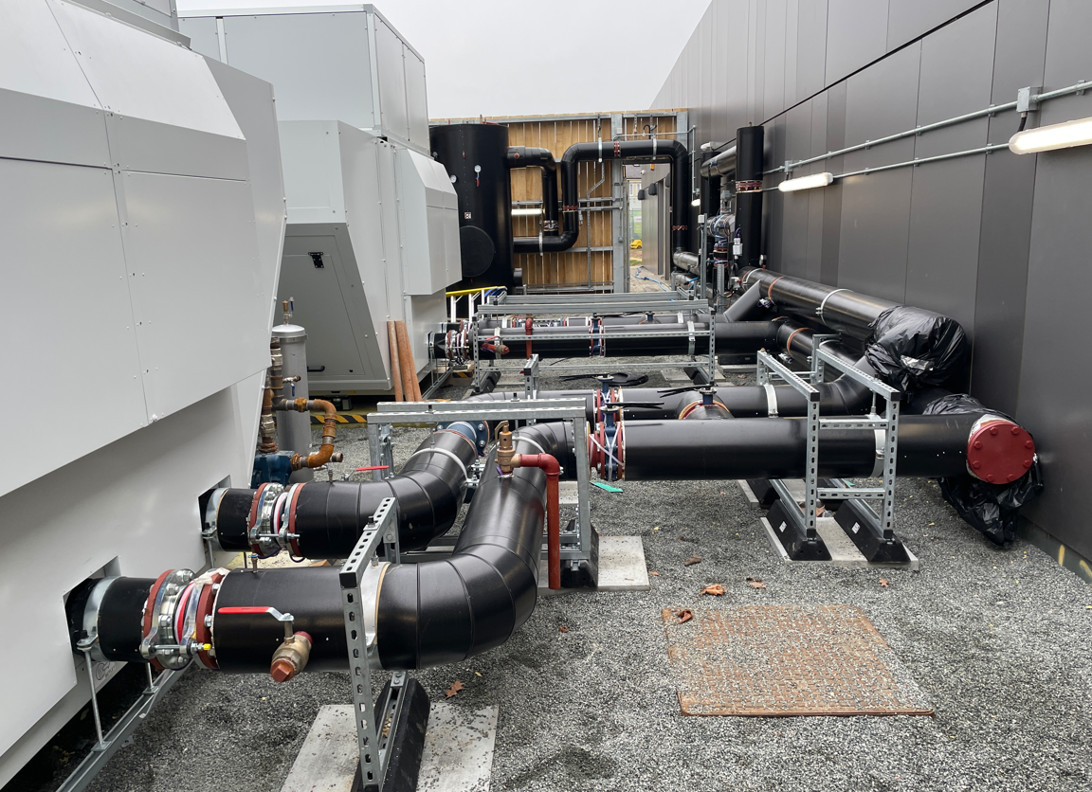
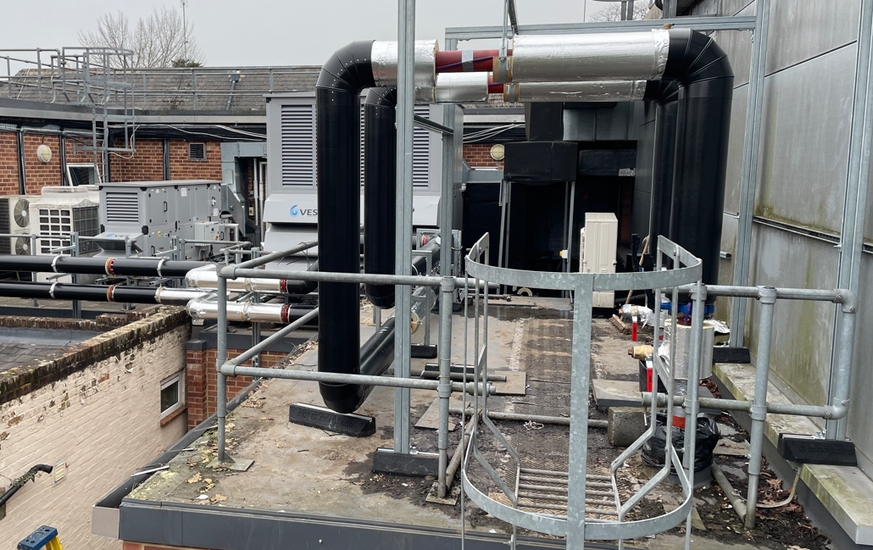
Sport Park Air Source Heat Pump
Project to reduce carbon use within the Sports Park facility and replace the existing, end of life gas boiler plant with dedicated Air Source Heat Pumps
Insert photo (s) here
Sustainability carbon reduction project
Project Manager : Patrick Abbott
Commenced : Mar 2024
Completion due : Mar 2025
Investment £2.9m

