Slide 1
The vocabulary of academic speaking: an interdisciplinary perspective
Michael McCarthy

Slide 2
Outline
Is spoken academic English like or unlike conversational English?
Are there discipline-specific constraints?
Insights from corpus analysis
How might these influence EAP materials?

Slide 3
Corpus evidence
ESP/EAP tradition began with the close analysis of written texts, with limited research on lectures
First spoken corpora, like written, tended to survey the language as a whole
Development towards smaller, targeted spoken corpora (e.g. workplace, media, EAP)
Now several good spoken academic corpora available (e.g. MICASE BASE), plus major publishers’ corpora

Slide 4
Some sub-corpora of MICASE
Biology
Engineering
Arts & Humanities
Each approx. 190k words

Slide 5
consistency
How much do the sub-corpora share with the whole corpus?
How much do the sub-corpora compare with non-academic speaking?

Slide 8
Frequency and Key words
Frequency: raw totals of occurrences
Key words: words occurring (or not occurring) with statistical significance

Slide 9
High-frequency items in academic speaking
MICASE & BASE: Frequency: (in top 100)
items associated with conversation, informality and interactive contexts: you, I, like
hesitation markers (um, uh)
discourse/pragmatic markers and/or response tokens (right, well, think, know, actually, okay)

Slide 10
Frequency versus key words: academic speaking vs. social conversation
 | frequency | key word
I |  | X
you |  | X
er |  | X
well |  | X
erm |  | X
right |  | 
mm |  | 
okay |  | 
know |  | X

Slide 11
In conversation, 66% of know = you know

Slide 12
Some examples from top 100 key words: MICASE & BASE
point
terms
sense

Slide 13
Some examples from top 100 key words: MICASE & BASE
point
terms
sense

Slide 16
Some examples from top 100 key words: MICASE & BASE
point
terms
sense

Slide 19
Some examples from top 100 key words: MICASE & BASE
point
terms
sense

Slide 20
Sense (MICASE)

Slide 22
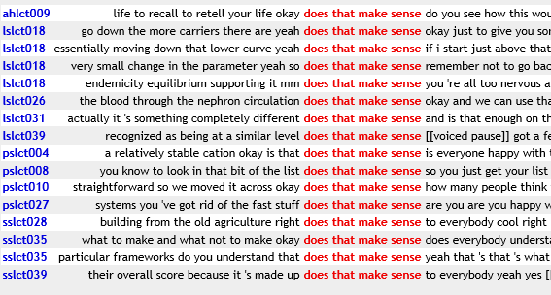
Does that make sense? (BASE)

Slide 23
Consistency: a further example
Distribution of pronouns is a key to stylistic differences

Slide 24
consistency
Shift in relative values of I and you
Notes:
In the detailed consistency analysis, I and you continue to have uneven distribution in the MICASE seminars, ranging from 277 occurrences to 93 per 10,000 words for I, and 319 to 240 for you, respectively. The range of variation is much less, though, than in the other corpora, with the ratio for I being only 3:1 from highest to lowest, and for you being 1.3:1. The seminars, then, seem to show a much more consistent use of these two highly interactive pronouns across different teaching events.

Slide 25
Variation across events: use of “I”
Notes:
The raw frequency is in med lec B is three occurrences of I, two are discourse-managerial (as I mentioned twice) plus one occurrence of I beg your pardon to correct a verbal slip.

Slide 26
conclusion
Academic speaking shares much in common with conversation (lexis, grammar, pragmatic marking)
No one prescribed or proscribed style: distribution of interactive vocabulary has discipline-specific implications
Institutional labels (lecture, seminar, tutorial) not an infallible guide to degree of conversational features
Different tools (frequency, key words, chunks, consistency) all add to nuanced picture
EAP and academically/vocationally oriented materials can directly teach the lexico-grammar of academic speaking
Learners need to be prepared for a wide range of possible styles

Slide 27
Thank you for listening

