Slide 1

‘More difficult than physics’: teaching and learning historical and political terms on an IFP
InForm Conference, Lindisfarne Centre, St Aidan’s College, Durham University
16th July 2016
Will Hutton, The Language Centre, School of Languages, Linguistics and Film, Queen Mary University of London

Slide 2
Outline
The context
Vocabulary in history and politics
Why working with key terms is crucial
Strategies – how educators foster acquisition
Can Moodle’s Glossary activity play a role in this enterprise?

Slide 3
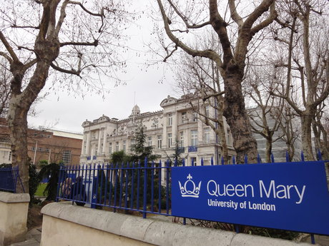
Programme objectives
Increase subject knowledge + overall ability in English
Develop study skills
Assist in adjusting to UK HE
Queen Mary International Foundation Programme in the Humanities and Social Sciences
Level 3 programme
Two cohorts
c.120 students
40+ nationalities
Many students have had an English-medium education and at least 50% have IELTS 7+ at entry
75% of credit for academic modules, 25% of credit for English
Top 60% tend to progress to QMUL
Choice of 10 subjects in addition to English Language and Study Skills
Wider institutional objectives
Queen Mary Graduate Attributes
Vision – Engage critically with knowledge
Realisation – Clarity of Communication
+ QMUL Model

Slide 4
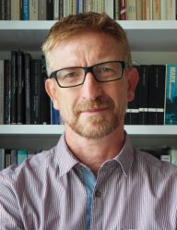
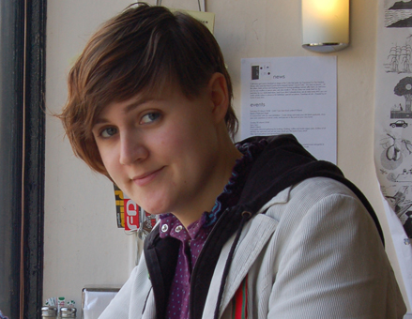
International Relations and Politics
Learning outcomes – handle political ideas
The current module considers three themes:
What is politics?
Political ideologies – liberalism conservatism
International Relations
“Politics is emphatically far more than the study of boring men in boring suits; politics is the study of power – the what, who, where, why and when of that universal phenomenon.” Tim Olvier, Univerisity of Hull writing in The Independent
Notes:
– power and the state – approaches to studying the structures of modern states, pluralism and elitism. Politcal value of freedom – equality and democracy
– liberalism conservatism
You will study the ideas which inform and explain political activity alongside political institutions and behaviour.
Charisma, anti-semitism, civil disobediance, coalition, cuorruption, colonialism, failed state, executive, globalisation , gender, laissez faire, status, totalitarianism

Slide 6
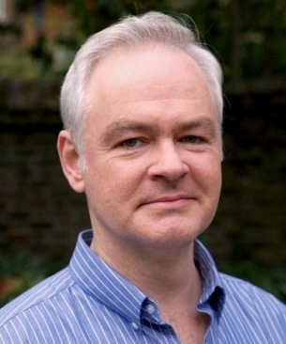
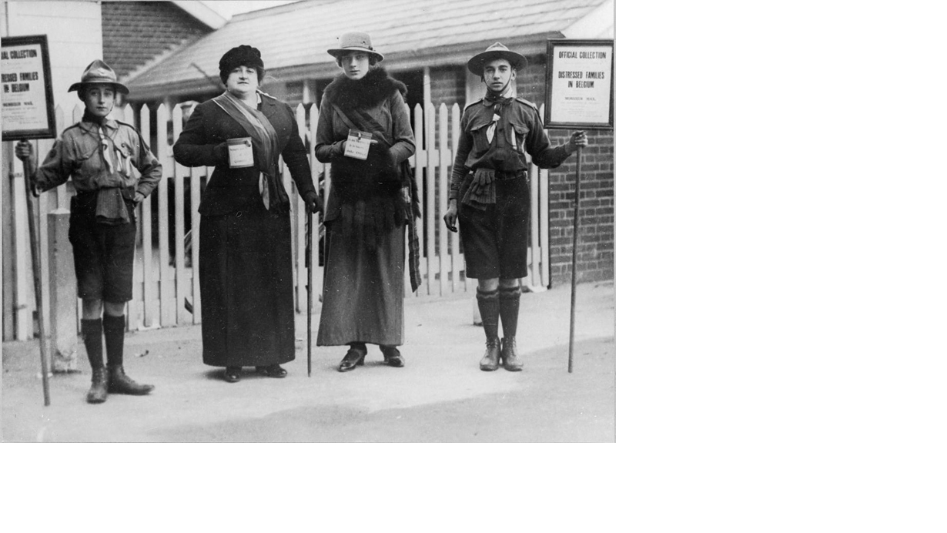
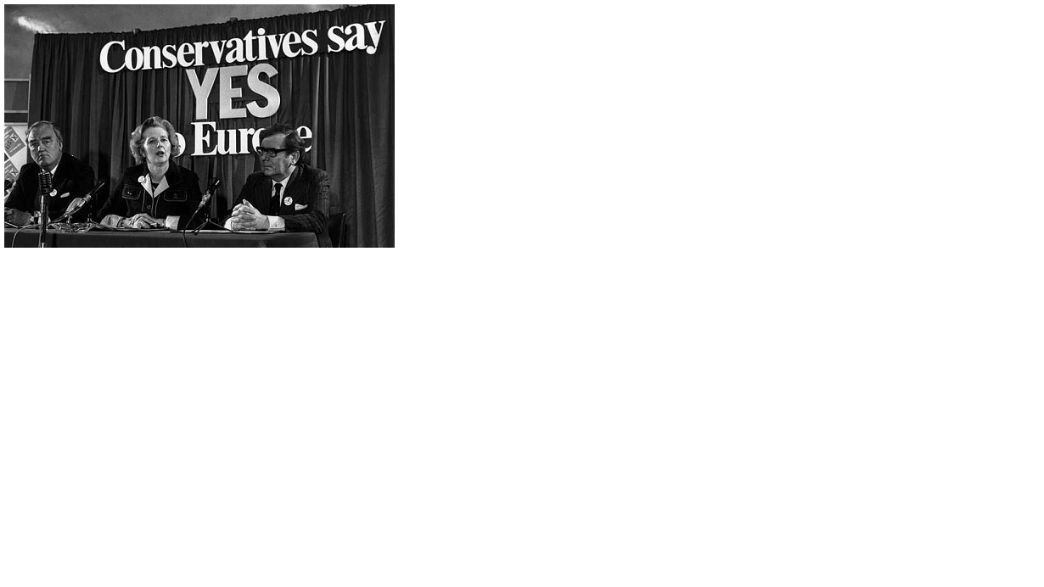
History
Twentieth Century History: the Making of the Modern World
Focus is on Europe
Outcomes: demonstrate basic knowledge of modern European history
Skills : assess evidence, interpret information, develop writing and oral presentation skills

Slide 7
Semester A
Week 1: An Introduction to the History Module
Week 2: The First World War (and The Russian Revolution)
Week 3: Inter-war Europe: from Versailles to the Wall Street Crash
Week 4: Hitler’s Germany
Week 5: (The Russian Revolution and) Stalin’s Soviet Union
Week 6: The Second World War
Week 7: Reading week - no classes
Week 8: Historical Skills week
Week 9: The conclusion and consequences of the Second World War and the founding of the United Nations and NATO
Week 10: The Cold War I: the origins of the Cold War and the threat of nuclear war
Week 11: Class test - date to be confirmed
Week 12: The Holocaust: visit to the Imperial War Museum - date to be confirmed
Semester B
Week 1: From European Communities to European Union
Week 2: European Decolonization: retreat or revolt?
Week 3: The Vietnam Wars of 1945-75
Week 4: Case study: Britain from the Workhouse to the Welfare State
Week 5: Mass affluence and technological progress
Week 6: The 'Cultural Revolution' of 'The Sixties' in the West and the rise of global youth and 'pop' culture
Week 7: Class test - date to be confirmed
Week 8: ‘The Generation of 1968’
Week 9: The changing lives of women in the Twentieth Century
Week 10: The Cold War II: Khrushchev to Gorbachev, and the era of Detente
Week 11: The Cold War III: the 'collapse' of Communism, and the 'triumph’ of Liberal Democracy?

Slide 8
Vocabulary in the two subjects
International Relations and Politics
“Politics is exciting because people disagree.” (Heywood, 1)
A social science- tends to deal in generalisations
Confusion between how the terms are used by practitioners of politics (politicians) and how they are used by those who study politics
Deals with ideological ways of seeing the world
“Concepts have a particular importance for students of politics. It is no exaggeration to suggest that political argument often boils down to a struggle over the legitimate meaning of terms” (Heywood 2000, 3)
History
Examination of specific events and processes/ developments
A humanity
“Whereas a historian is likely to want to make sense of a particular event . . . a political analyst is more likely to study such events with a view to making sense of a larger or more general phenomenon” such as revolution (Heywood 2000, 3)
historians interested in what is different or unique about a particular set of events
“The past itself is not a narrative. In its entirety, it is as chaotic, uncoordinated and complex as life. History is about making sense of that mess, finding or creating patterns and meanings and stories from the maelstrom.” (Arnold 2000, 13)
Notes:
Both subjects emphasise independent thought and skills
History in general Both encourages and develops both conceptual and thematic thinking and requires the results to be expressed coherently and persuasively.
History as a provisional, ever-evolving body of knowledge – the difference between history and the past – history is an interpretation (creating a narrative from the past)

Slide 9
Why are they challenging?
Language constrains certainly, but also about
Nation
Ideological frameworks which differ over time and space
Political language – informative (referential function) or persuasive (conative function)
Abstract nouns abound in both disciplines which often have multiple meanings
Unfamiliar proper nouns
Sheer number of terms
A new geographical perspective
Notes:
That’s why we require IELTS 6 for the IRP module
Nation – from the Latin Nasci – a complex phenomena shaped by a collection of factors – culture (a group of people bound by common language, history and religion) Political nation – natural political community Psychologically – group distinguished by shared loyalty or affection – patriotism

Slide 10
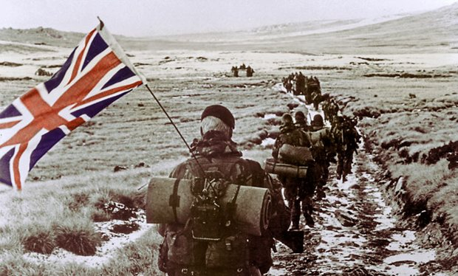

Notes:
The Falklands War
Where are they?
What happened?
What are the different perspectives/interpretations?

Slide 11
All about contestability/perspective – how can this be developed?
In both disciplines, key terms are often contestable and at university level students need to grapple with different perspectives in order to succeed.
In dealing with these key terms either orally or in writing, students, it is hoped will develop their ability to
Make connections
Compare and contrast
Evaluate and place emphasis
Report what offers say
Notes:
Precision is essential- glossary – nuances of meaning –terminology – transparent – subtle distinctions – different senses of the same word ambiguous – misinterpret – clarify – definition – coherent – connotations – perspective
Concept, notion, stance, viewpoint, perception, model

Slide 12
Creating an environment for effective vocabulary acquisition (Blachowicz et al, 2006)
A language and word-rich environment that fosters ‘word consciousness’
Intentional teaching of selected words with multiple types of information about each word together with opportunities for repeated exposure, use and practice
Teaching word-learning strategies that give students the ability to learn new words independently

Slide 13
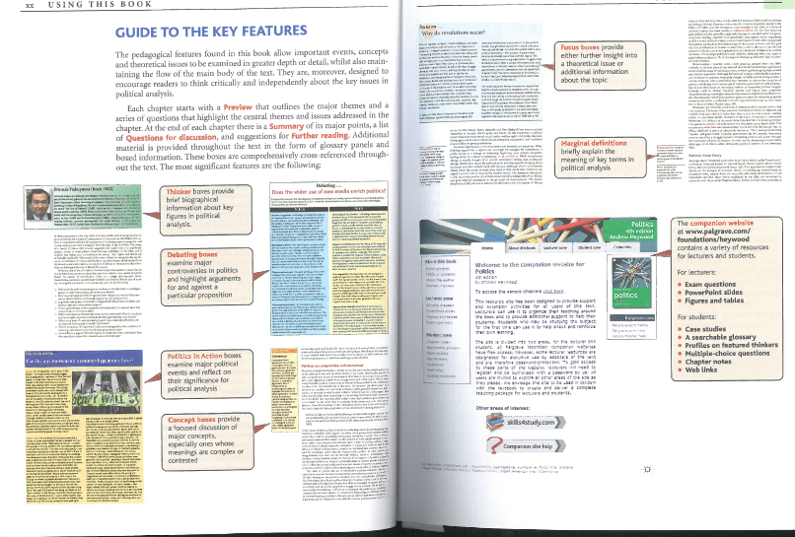

Slide 14
Learning vocabulary
Learners discovering meaning through the manipulation of language
Three stages
Noticing
Experimenting
Producing
Notes:
Asking others
Using a dictionary
Making use of the context to deduce meaning
Memory – aided through meaningful tasks, use of imagery, rote learning, recycling

Slide 15
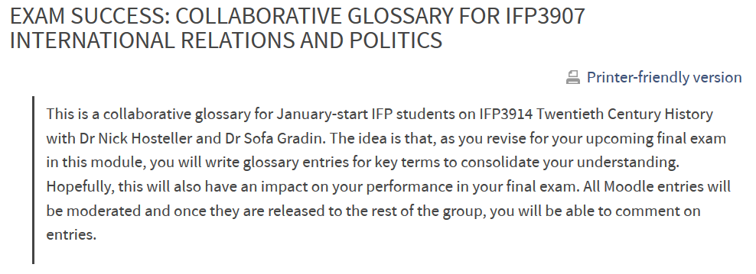
What role can the Moodle Glossary function play here?

Slide 16
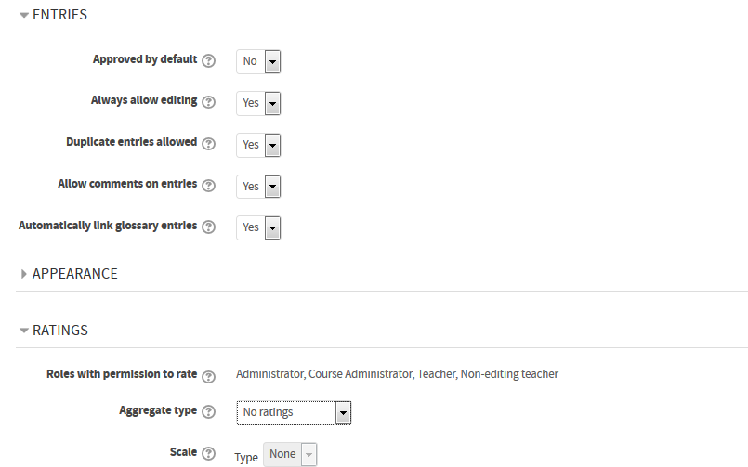

Slide 17
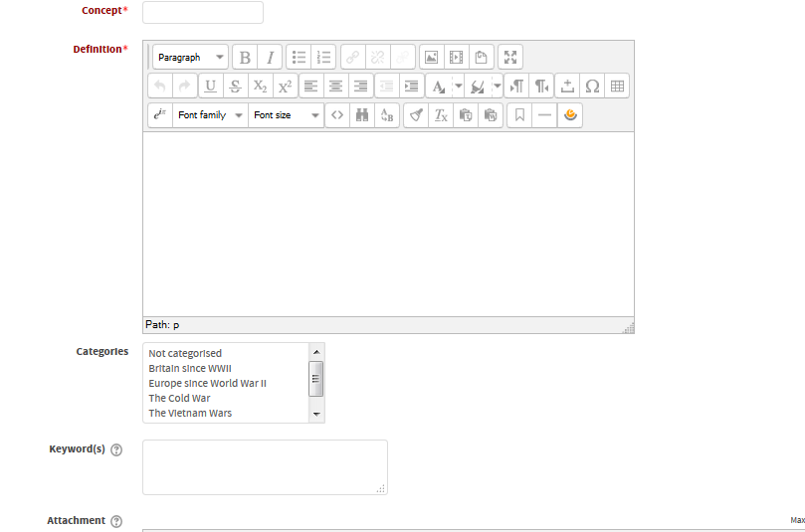
Creating a Glossary Entry

Slide 18
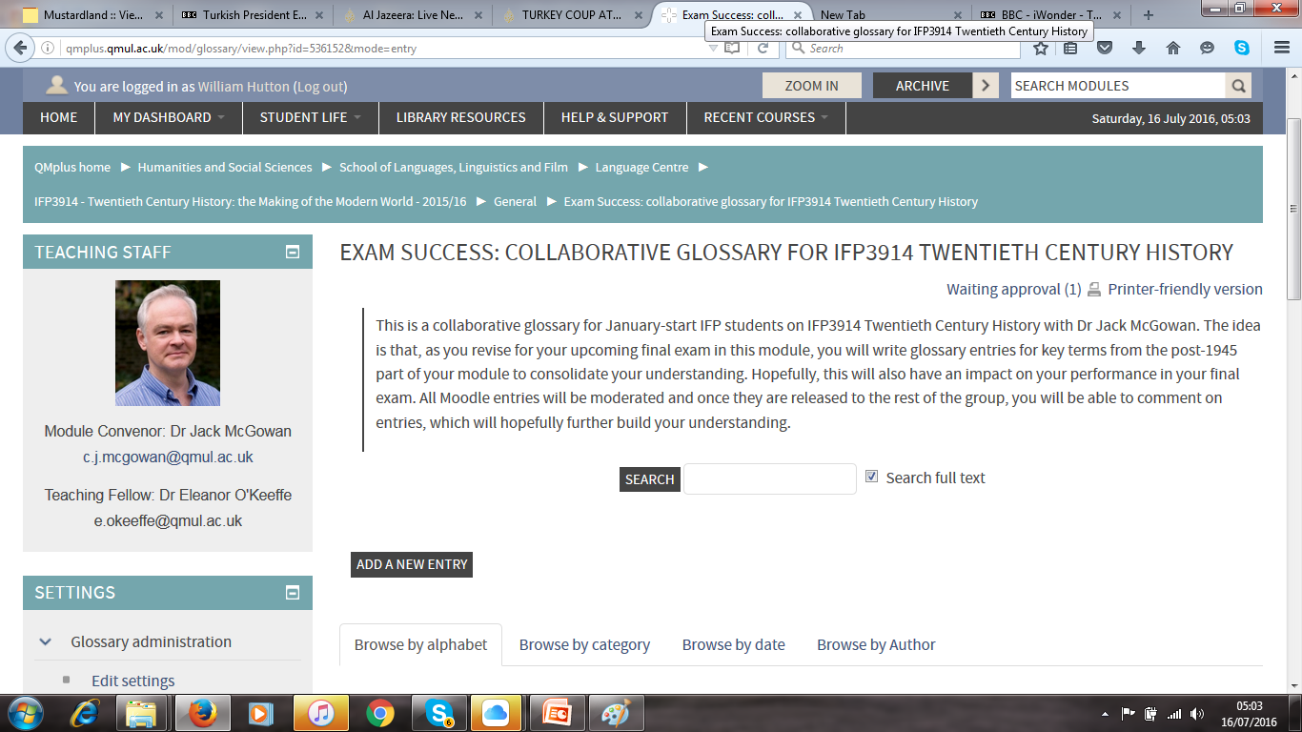

Slide 19
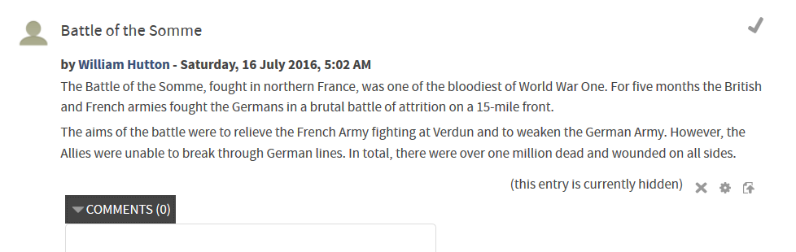
Moderating entries

Slide 20
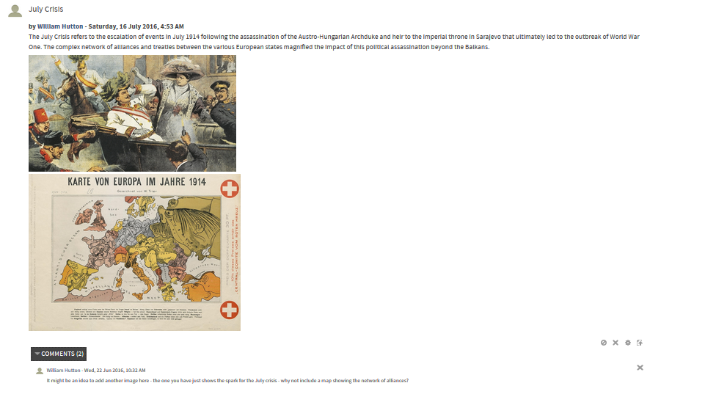

Slide 21
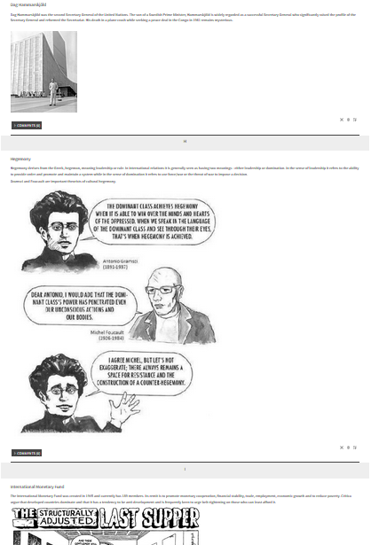
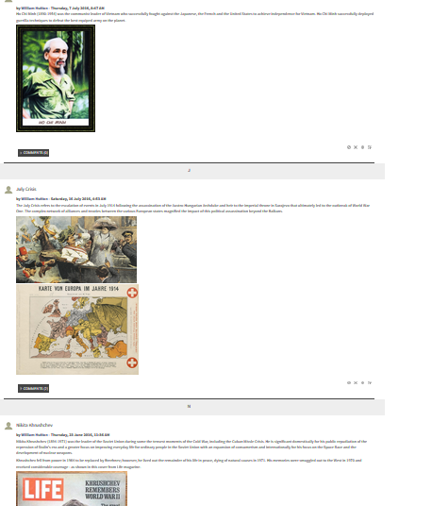

Slide 22
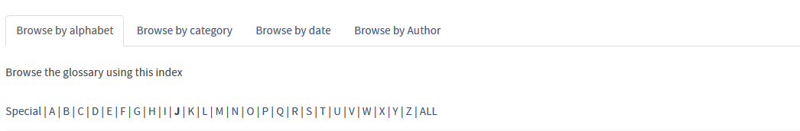
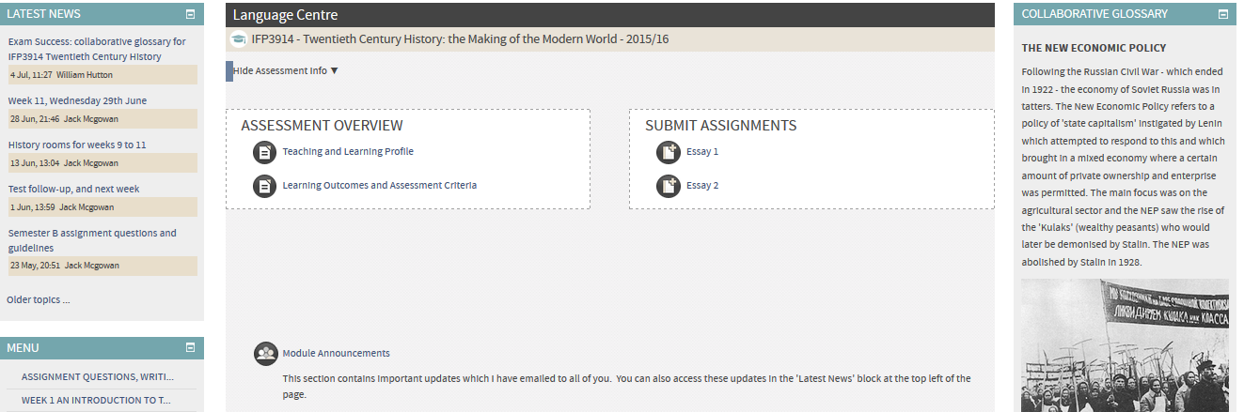

Slide 23
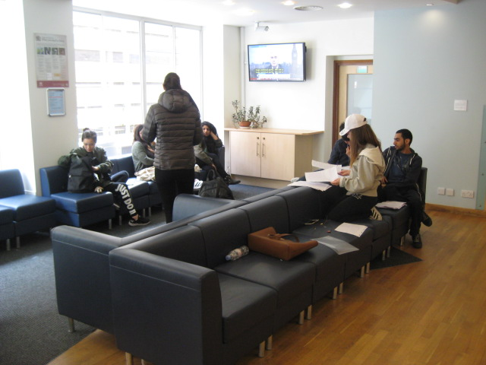
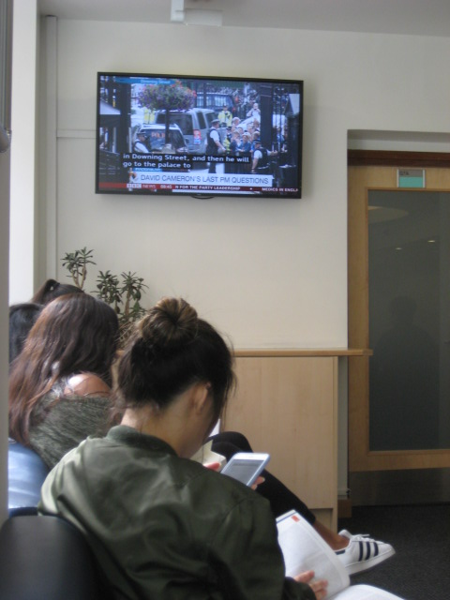

Slide 24
What next?
Will Hutton
w.e.hutton@qmul.ac.uk

Slide 25
References
Arnold, John (2000) History: A Very Short Introduction Oxford University Press
Blachowicz, Camille et al (2006) Vocabulary: Questions from the classroom Reading Research Quarterly 41:4
Heywood, Andrew (2000) Key Concepts in Politics St Martin’s Press
Heywood, Andrew (2013) Politics Palgrave Macmillan

