Slide 1
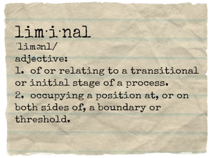
QUESTIONS OF TRANSITION AND LIMINALITY ON FOUNDATION PROGRAMMES
Martin Millar and Clare Nukui
June 30 2018 InForm Conference Presentation

Slide 2
INTRODUCTION
“The Foundation year eased the transition between the secondary school and university method of education”
Outline of today’s talk
Definition of liminality
Liminality in the field of Education
1 and 4 year Foundation Programmes from institutional and student perspectives
Level 4 modules on Foundation Programmes

Slide 3
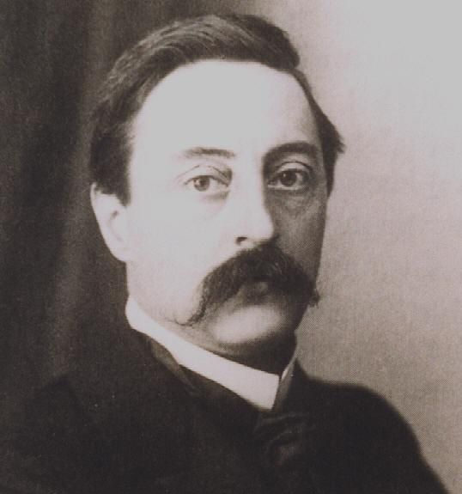
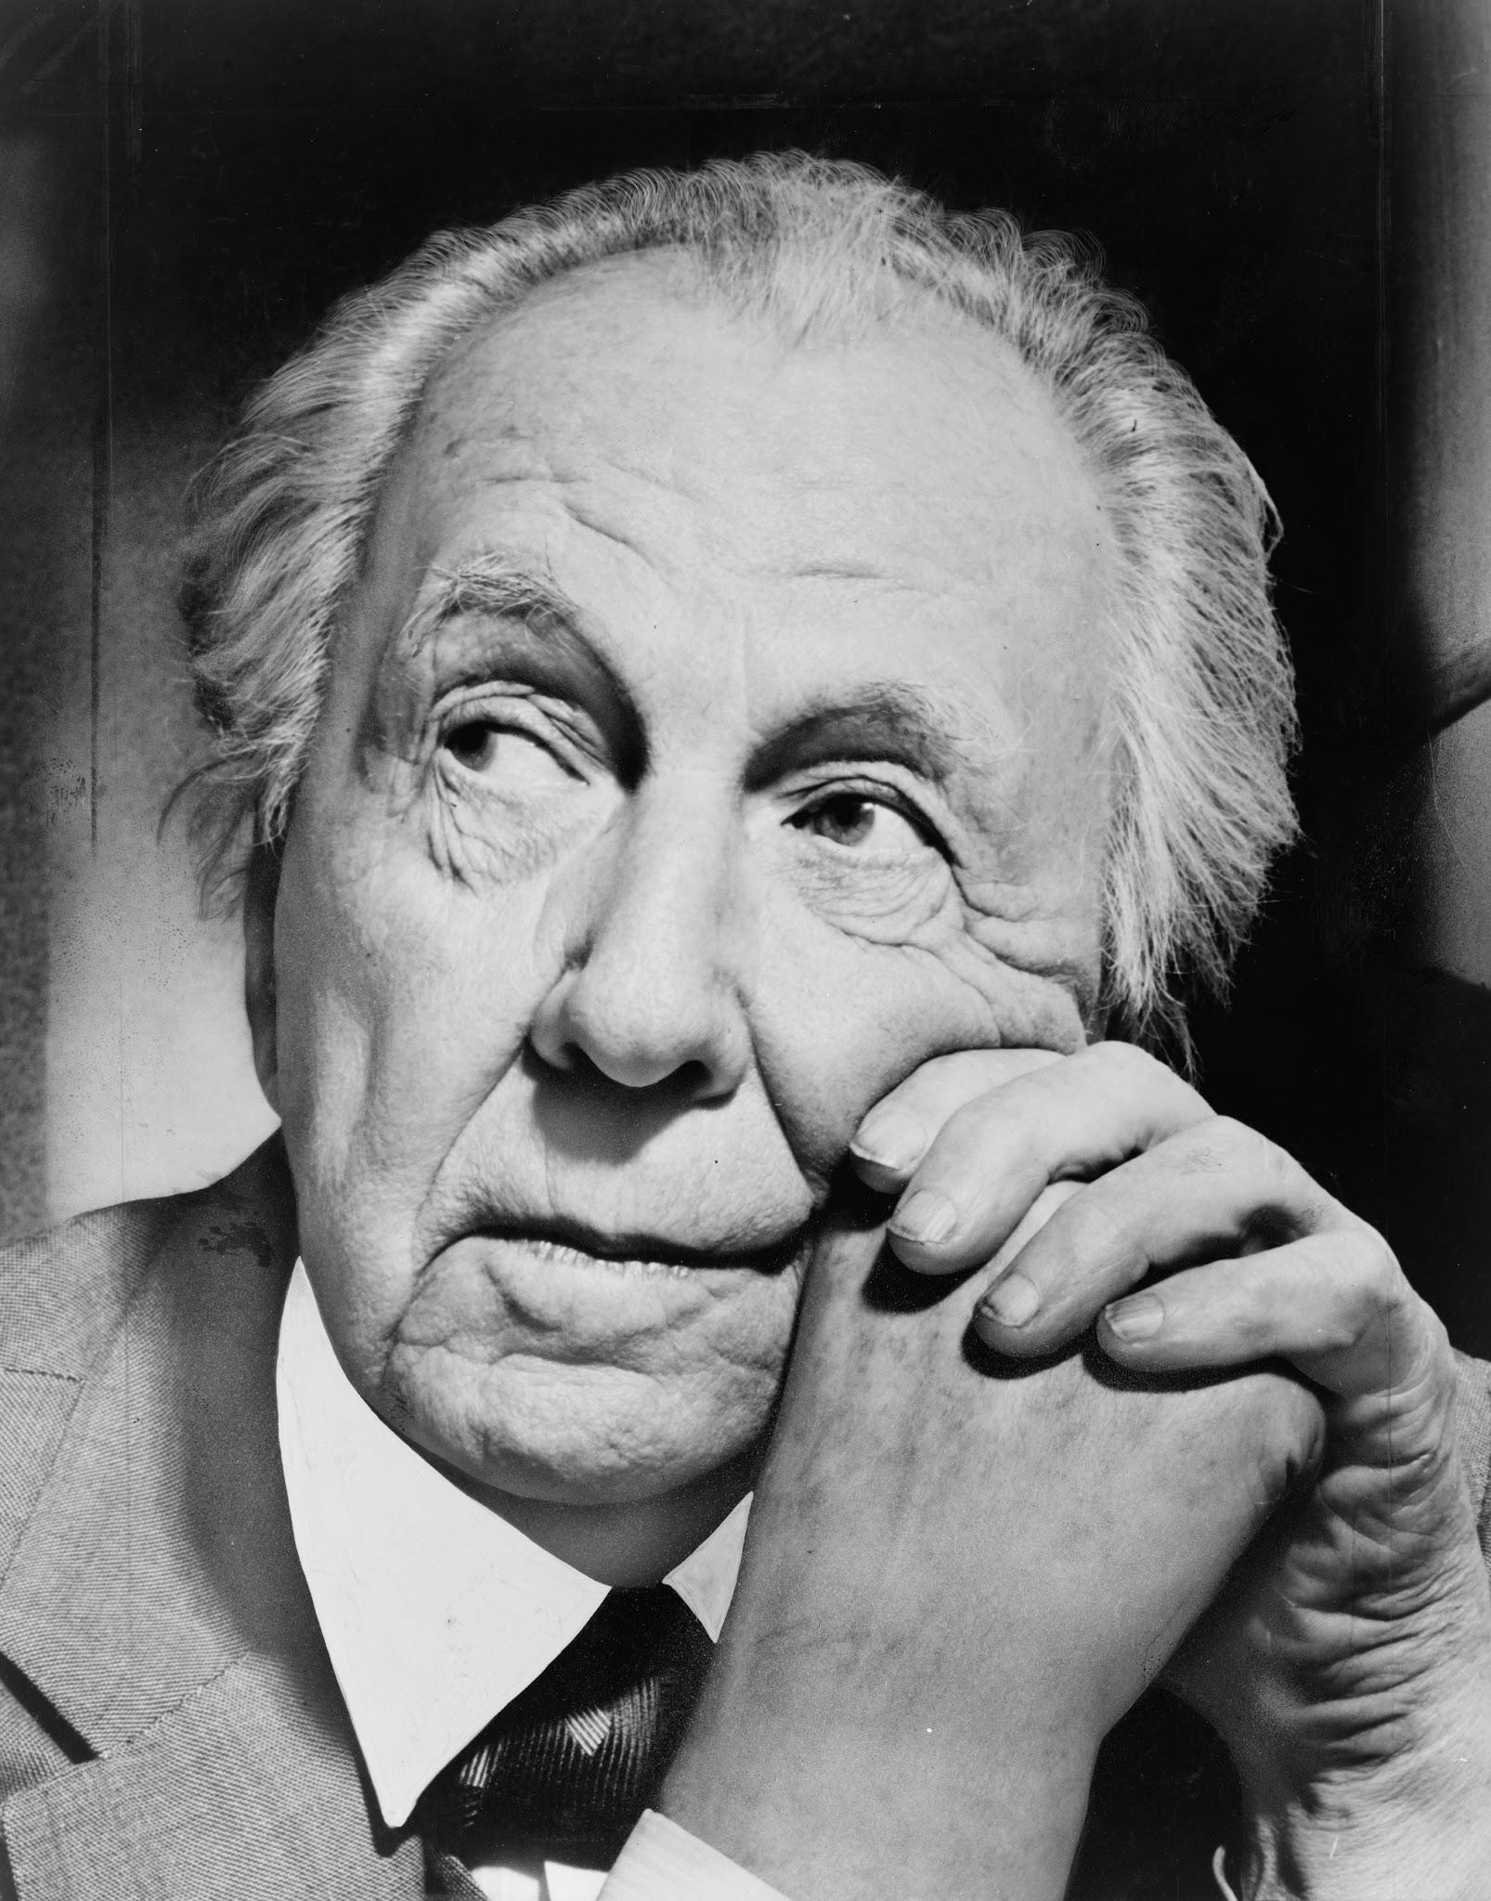
LIMINALITY
van Gennep and rites of passage- 1909
Turner and the Ndembu - 1967
Separation-liminality-re-assimulation
Ambiguity- betwixt and between-known to unknown

Slide 4
FEATURES OF A LIMINAL SPACE
Isolated
Special clothes and hairstyles
Entry and exit ceremonies
Obedience and humility
Lifelong friendships

Slide 5
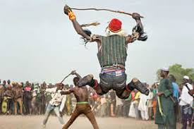
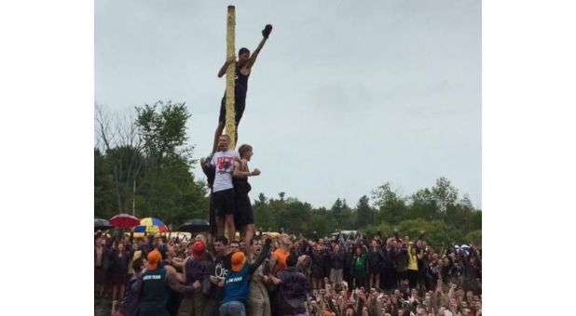
RELEVANCE FOR TODAY?
Levi-Strauss- The Raw and the Cooked
Fulani stick ceremony and Queen’s University greasy pole

Slide 6
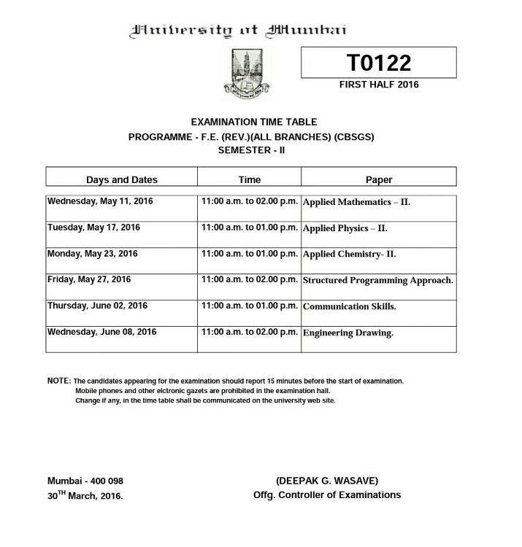
LIMINALITY- A FLABBY CONCEPT?
Balduk in Wels et al (2005)
...but flexible adaptation and application to areas such as Tourism, Aging, Cyberspace and Education...
Bounded time- entry and exit points, timetables, deadlines for assignments, tests and exams

Slide 7
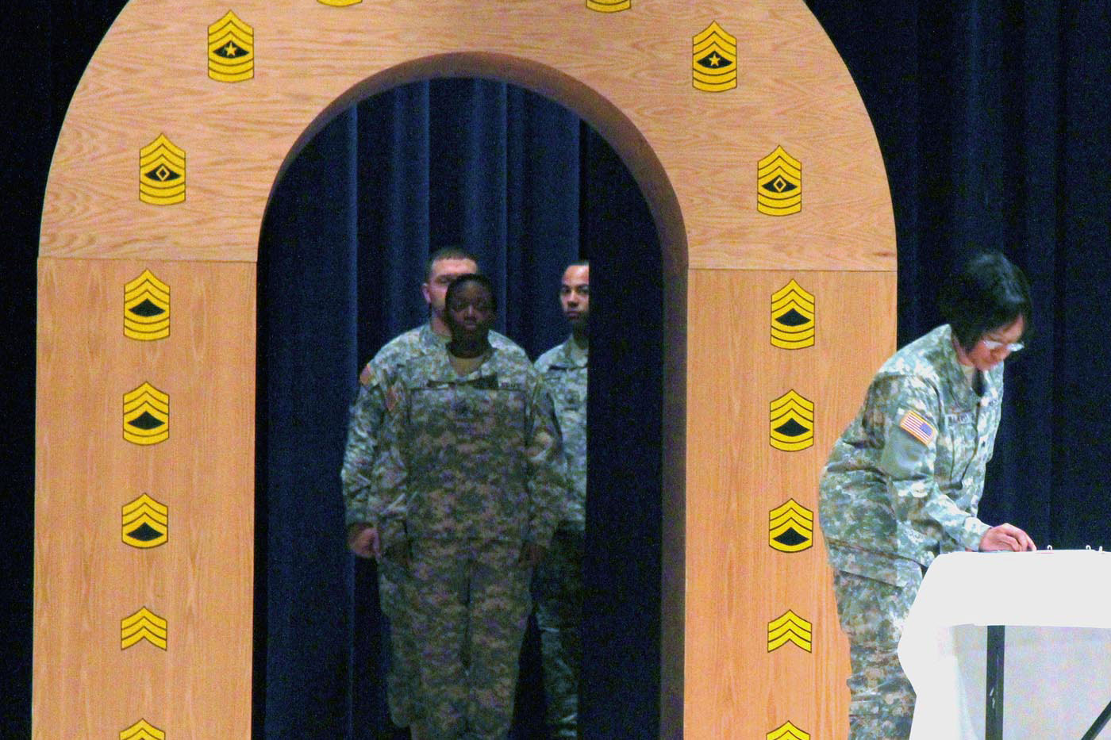
THRESHOLD CONCEPT FRAMEWORK
A portal- a new way of seeing
Academic literacy- difficult to acquire but transformational
“The superordinate and non-negotiable characteristic of a threshold concept is its transformative capacity” Meyer and Land (2005)

Slide 8
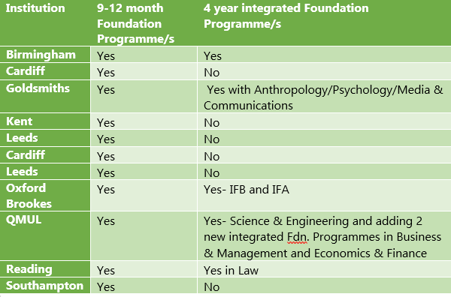
UPA- 1 YEAR VERSUS 4 YEAR INTEGRATED FOUNDATIONS

Slide 9
NUMBER OF STUDENTS ON OUR PROGRAMMES
Nos. of students on our integrated Foundation Programmes: 83
Percentage of EU/international students:
IFB: 24%
IFA: 12%
Total EU/international: 36%
Nos. of students on our 1 year Foundation Programmes: 31
Percentage of EU/international students:
FIP: 39%
IFP: 37%
Total EU/international: 76%

Slide 10
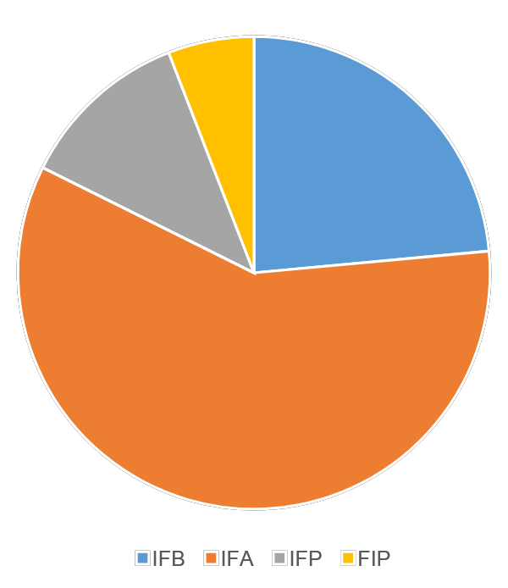
PROGRAMMES OF RESPONDENTS
On average students marked themselves between partially and completely agreeing with the statement:
“Being able to progress without completing a UCAS form is an advantage”

Slide 11
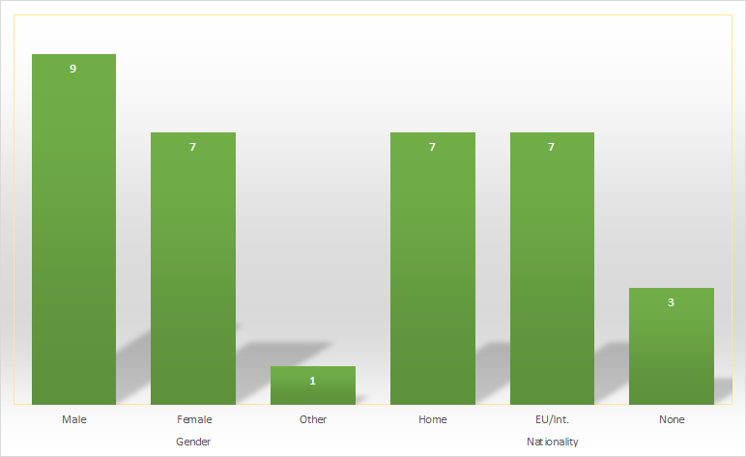
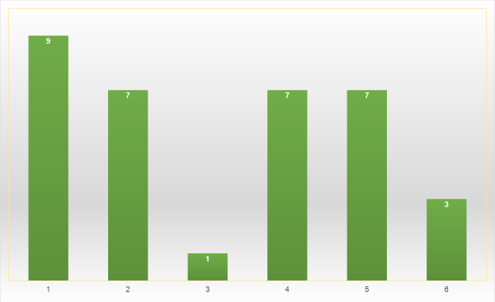
GENDER AND NATIONALITY OF RESPONDENTS

Slide 12
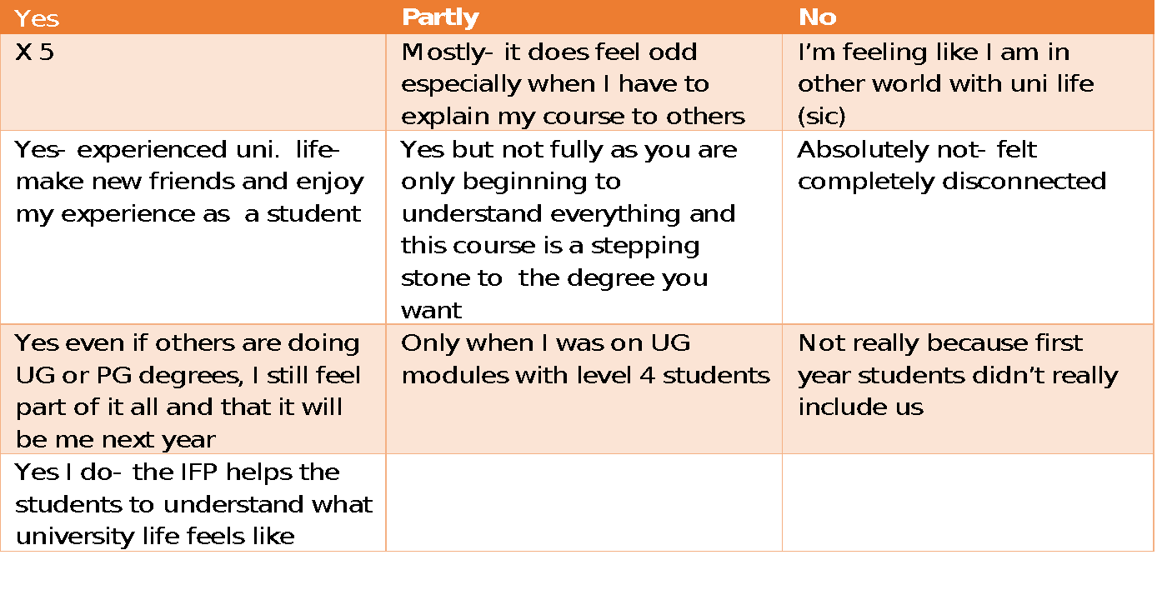
FEELING PART OF THE UNIVERSITY

Slide 13
FOUNDATION PROGRAMMES AND LIMINALITY
Making liminality explicit:
“During the first year you will be improving your skills and increasing your subject knowledge. You will go straight on to the main degree course. When you graduate it will be as though you have graduated from the 3-year degree. The same student finance package applies to foundation years as to standard 3 year degrees”
University of Swansea website

Slide 14
1 AND 4 YEAR FOUNDATION PROGRAMMES
LIMINAL
SECONDARY SCHOOL
LIMINAL
SECONDARY SCHOOL.
LIMINAL- STUDY SKILLS AND SUBJECT KNOWLEDGE ACQUIRED
LIMINAL- STUDY SKILLS AND SUBJECT KNOWLEDGE ACQUIRED
FOUNDATION- 1-YEAR
YEAR 0 plus 3 INTEGRATED DEGREE
LIMINAL- SUBJECT KNOWLEDGE ACQUIRED
DEGREE

Slide 15
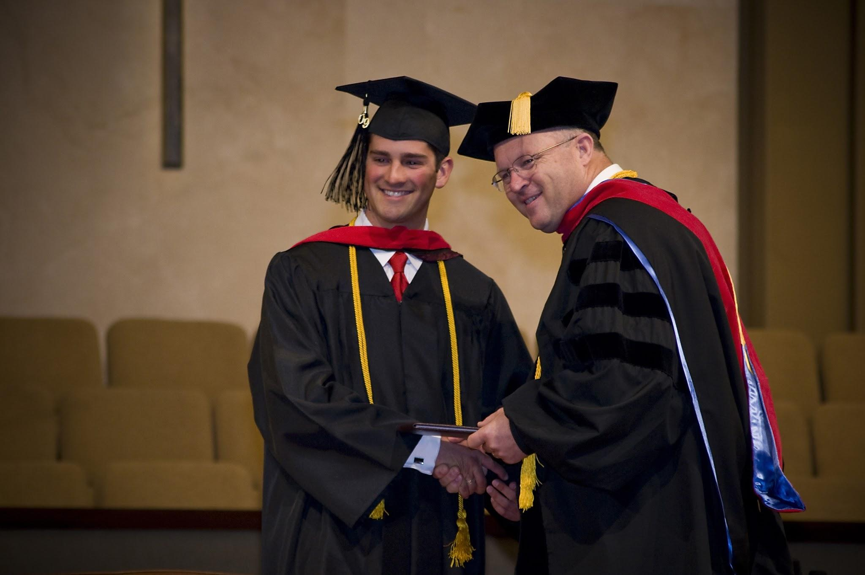
FROM LIMINAL TO MASTER

Slide 16
WORDS USED BY STUDENTS TO DESCRIBE THEIR LEVEL 4 UG MODULES
The top four adjectives used in order of frequency were:
Interesting
Challenging
Enjoyable
Informative

Slide 17
REFERENCES
Magolda, Peter Mark. "Ritual, Ceremonies, and Cultural Meaning in Higher Education (review)." The Journal of Higher Education, vol. 73 no. 4, 2002, pp. 543-545. Project MUSE, doi:10.1353/jhe.2002.0040
Meyer, J.H.F. & Land, R. High Educ (2005) 49: 373. https://doi.org/10.1007/s10734-004-6779-5
Trubshaw, B. (2003). ‘The metaphors and rituals of place and time - an introduction to liminality, or Why Christopher Robin wouldn’t walk on the cracks’, available at ttp://www.indigogroup.co.uk/edge/liminal.htm.
Turner, V. 1969 The Ritual Process: Structure and anti-Structure Routledge and Kegan Paul London
van Gennep, A. 1960 The Rites of Passage Routledge and Kegan Paul London
Wels, H., Vander Waal, K., Spiegel, A., Kamsteg, F. Anthropology Southern Africa, 2011, 34 (1&2)

