Slide 1
Are you GCRF ready?
Research Deans’ Office
29 March 2017
Dominik Zaum

Slide 2
Why Focus on gcrf
New Stream of Research Funding that aligns well with strength of Reading across all five research themes
Scheme with particular requirements
  ODA eligibility
  Emphasis on partnerships with Southern, and with non-academic partners
  Emphasis on interdisciplinarity
  Ambition to engage all disciplines in research in developing countries

Slide 3
Reading Engagement with GCRF
Support from the University
  Training and facilitation
  Development of Dedicated Guidance on Ethics and Duty of Care
  Dedicated Research Development Manager Post
Huge engagement from academics
  Engagement with GCRF consultations
  Very active as panel and review college members
  Active – and very successful with GCRF applications across most Research Councils (ESRC, BBSRC, MRC, NERC)

Slide 4
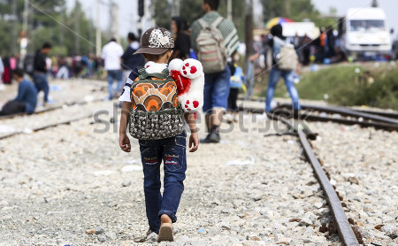
Prosperity and Resilience focusses on the institutions and practices that enable us to prosper as individuals and societies, and that help us to build resilience against sudden shocks, be they economic, social, political, or environmental.

Slide 5
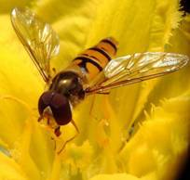
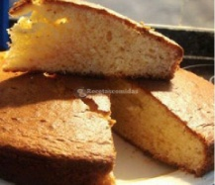

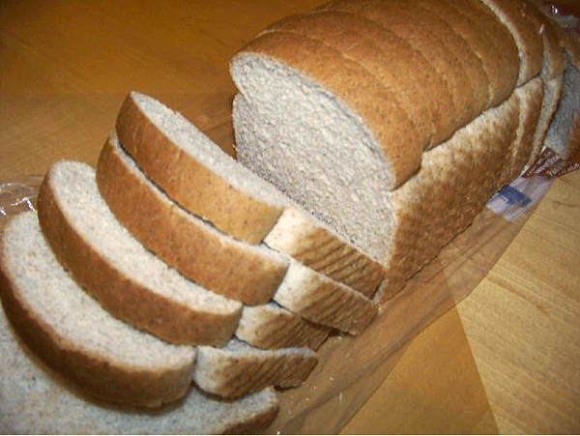
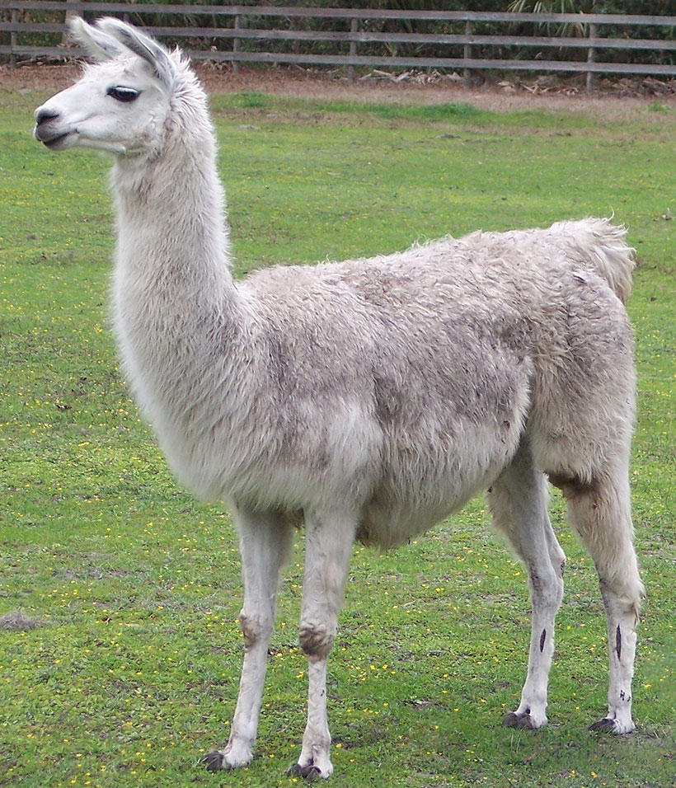
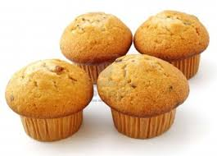
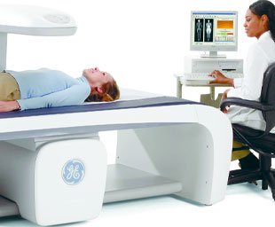
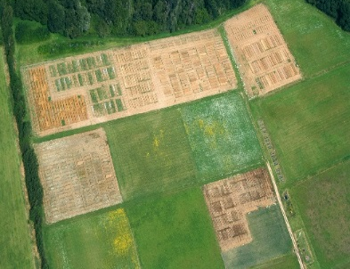
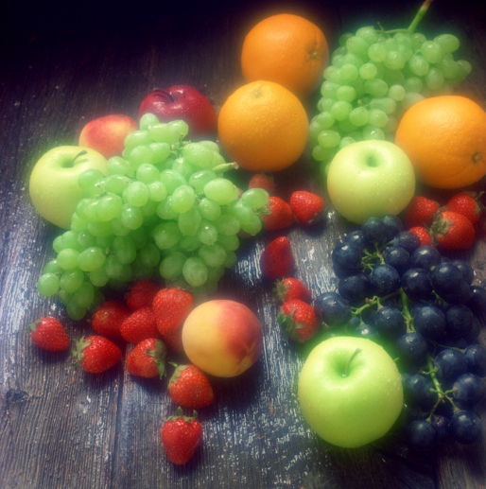

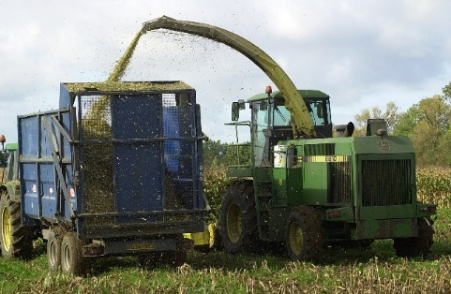
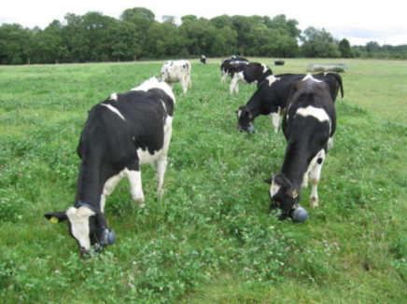
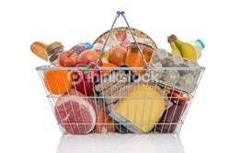
Food and Agriculture Research at Reading
Richard Bennett
Prof Agricultural Economics
Research Dean (Food)
Notes:
Ranked 10th for Agriculture and Forestry (and Food) QS World Rankings
100 core academic research staff plus 65 PDRAs, lab technicians, 200 PhDs…
Multi- and Trans-disciplinary research – e.g. links to Global Development, Health, Environment
Agri-Food Economics and Social Science,
Food and Nutritional Sciences,
Sustainable Agriculture and Food Systems

Slide 6
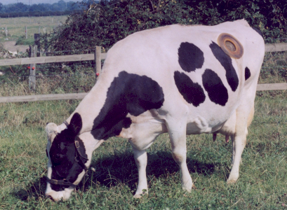
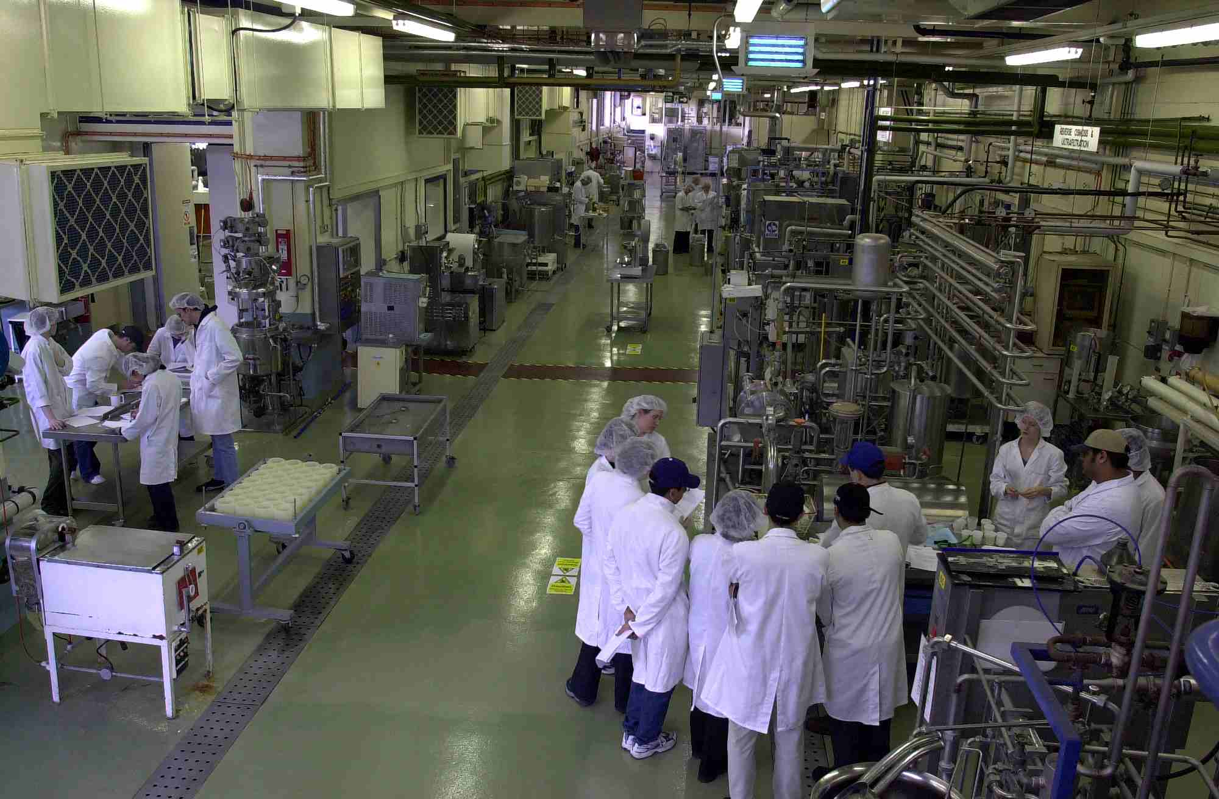
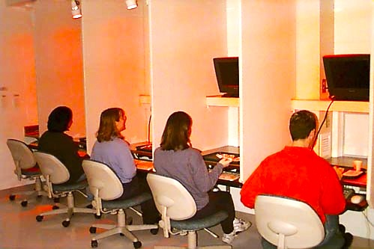
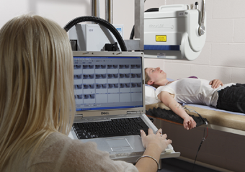
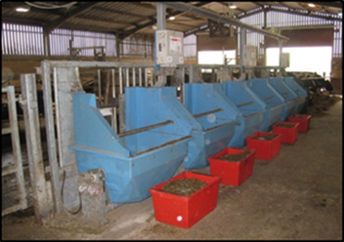
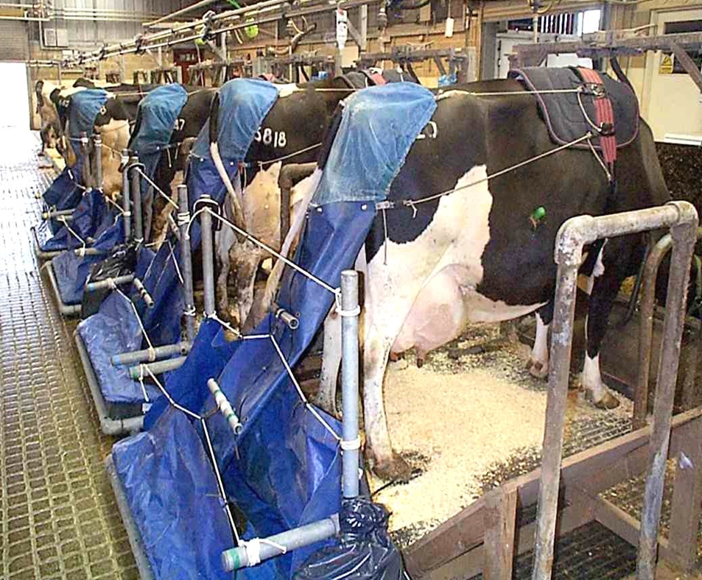
Example
Notes:
‘joined up along the food supply chain’ our research is/can be (i.e. we feed the diary cows to manipulate the milk which can then be processed in the pilot plant and fed in trials to assess consumer acceptance and effects on health (e.g. on the cardio-vascular system) in the short and longer term (clinical trials)

Slide 7
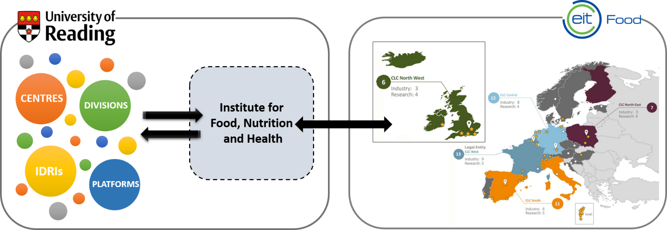
Recent initiatives
Institute for Food, Nutrition and Health:
  Food systems approach to nutrition and diets
£420M EIT FOOD (KIC) – Reading CLC NW Europe

Slide 8
Breadth of research: examples
  Food and health: Understanding gut microbiome and health; food discourses on social media and food preferences in young people
  Food chain: Reducing food waste and environmental emissions from food systems e.g. biodegradable packaging, spoilage control, reduction in methane emissions from livestock
  Economics: animal health, ecosystem services – e.g. trade in agriculture and food post Brexit, disease control decision making, valuing pollination
  Efficient agricultural and food systems: phosphate use efficiency, precision use of pesticide, climate stability, pollination

Slide 9
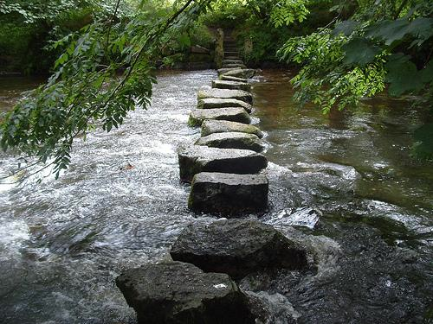
ENVIRONMENT THEME
Our ambition….. is to enhance our standing as a leader in research and higher education … among the very best universities
in the UK and
internationally
2026
Educating for 21st century lives
Securing and sustaining societies
Advancing policy and practice
2017
Phil Newton Research Dean Environment

Slide 10
What’s the point of the Environment Theme?
To help create research of greater quality, reach, power and impact

Slide 11
Mono-, Multi- & Inter-disciplinarity
ENVIRONMENT
FOOD
I am a
Research
Dean
PROSPERITY & RESILIENCE
HERITAGE & CREATIVITY
HEALTH
Increasingly focused on real-world problems

Slide 12









Land Surface Processes @ University of Reading
Water@Reading
SOIL RESEARCH CENTRE
Delving into our earth
Climate, Culture and Society

Slide 13
Heritage & Creativity
Research Theme
Research Divisions
Research Centres
Heritage
&
Creativity
Modern Languages and Linguistics
Centre for Information Design
History
Centre for Cognition Studies
Classics
Centre for Collections-Based Research
Film, Theatre and Television
Early Modern Research Centre
Philosophy
Samuel Beckett Research Centre
English Literature
Graduate Centre for Medieval Studies
Archaeology
Art
Centre for Film Aesthetics and Cultures
Typography and Graphic Communication

Slide 14
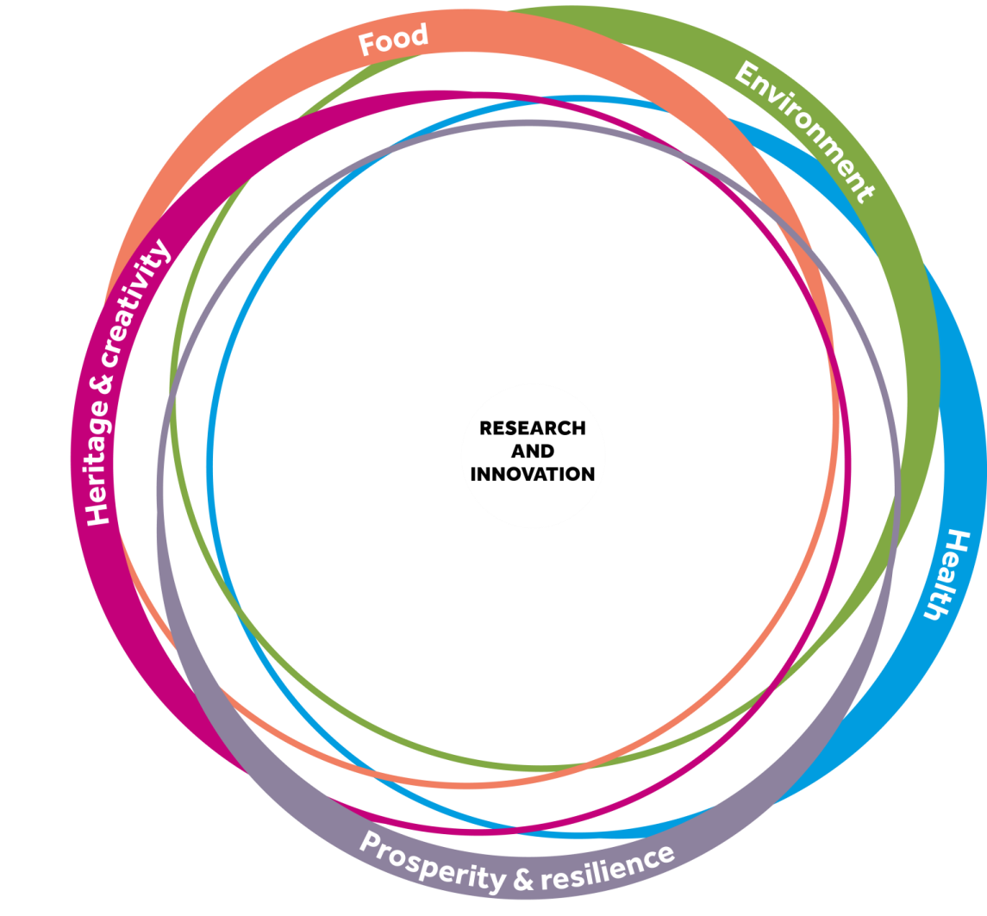
Heritage & creativity strengths
Connecting creative practice with social and historical research
Connecting with partners & diverse audiences
Co-production, co-creation
Thematic focus on migration, conflict,
& communication (through language,
information design, film, art,
theatre, literature)
Capacity building in heritage &
cultural protection (archaeology,
history, English literature, art)

Slide 15
migration, conflict,
& communication
Linguistics (Tony Capstick): Language Policies & Practices in Refugee Settings
(co-I ESRC/GCRF network - Greece, Italy, Lebanon, Egypt, Tunisia)
Modern Languages (Federico Faloppa) : Migration & Language Policies in Italy
(impacting on public debate, media, language education policy)(co-I ESRC/GCRF)
Modern Languages (Hilary Foottit): ‘The Listening Zones of NGOs: languages
and cultural knowledge in development programmes’ (AHRC)
Typography (Alison Black): Information Design for Meteorological
research that aims to assist African farmers in decision-making
Film Theatre & TV (Teresa Murjas ) ‘War Child’ mixed media reflections on
child experience of dislocation in WWII (Arts Council)

Slide 16
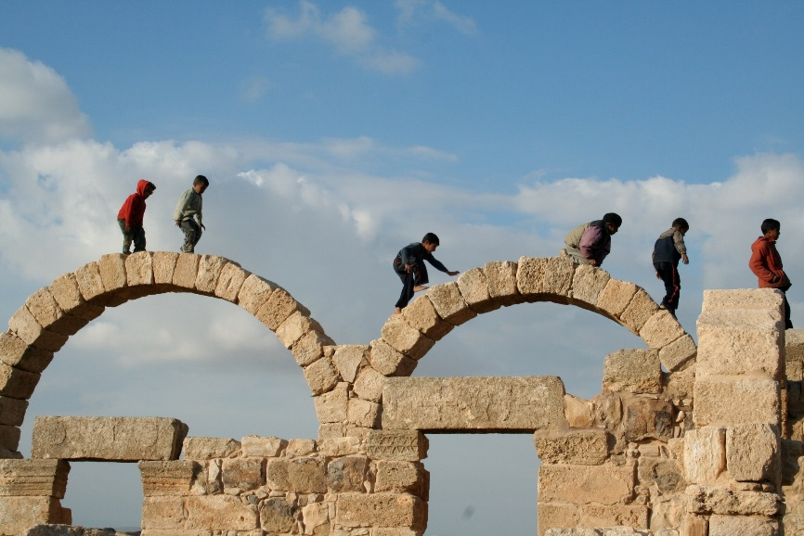
Capacity building in Heritage
English Literature (David Sutton): ‘Diasporic Literary Archives’ – preservation, recording, rescue of archives at risk in Namibia and elsewhere – links with UNESCO, International Council on Archives
Archaeology (Steve Mithen): Archaeology supporting development through eco-tourism in Jordan (AHRC/ODA)
Archaeology (Roger Matthews &
Wendy Matthews): Slemani Museum, Iraq
Prehistory Gallery refurbishment – cultural
protection through education and
public engagement (DCMS/GCRF
application in prep)
Notes:
This research project is funded by the Arts & Humanities Research Council (AHRC), and runs from 2012-2015. The University of Reading, alongside project partners, the University of Chester and the Victoria and Albert Museum, will be creating a database and research materials relating to all professional productions of Beckett's theatre throughout the UK and Ireland.
It will draw on original archival material in the University of Reading's world-leading Beckett Collection, the Victoria and Albert Museum's Theatre and Performance archives in London, and other archive collections across Britain and Ireland. The project will examine the role Samuel Beckett played in shaping modern theatre practice in the UK and Ireland and will enable a unique picture of British and Irish theatres to emerge through their approaches to staging Beckett.
The project will be a pilot for a national performance database which will hold information about UK past and future performances. Once the Staging Beckett project is completed in 2015, the V&A plans to make the Beckett database available online as a resource for researchers, linked to a project website at the University of Reading.
The Staging Beckett project is led by Professor Anna McMullan (University of Reading), Dr Graham Saunders (University of Reading) and Professor David Pattie (University of Chester), in partnership with the Victoria and Albert Museum. Our team includes two postdoctoral researchers, Dr Patricia McTighe (Reading) and Dr David Tucker (Chester), and a PhD student, Matthew McFrederick.

Slide 17
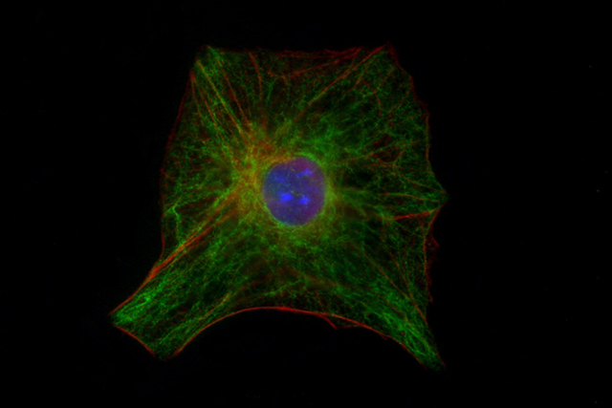
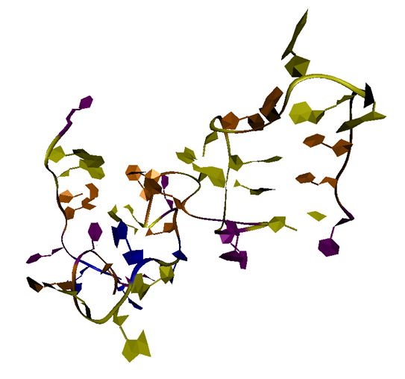
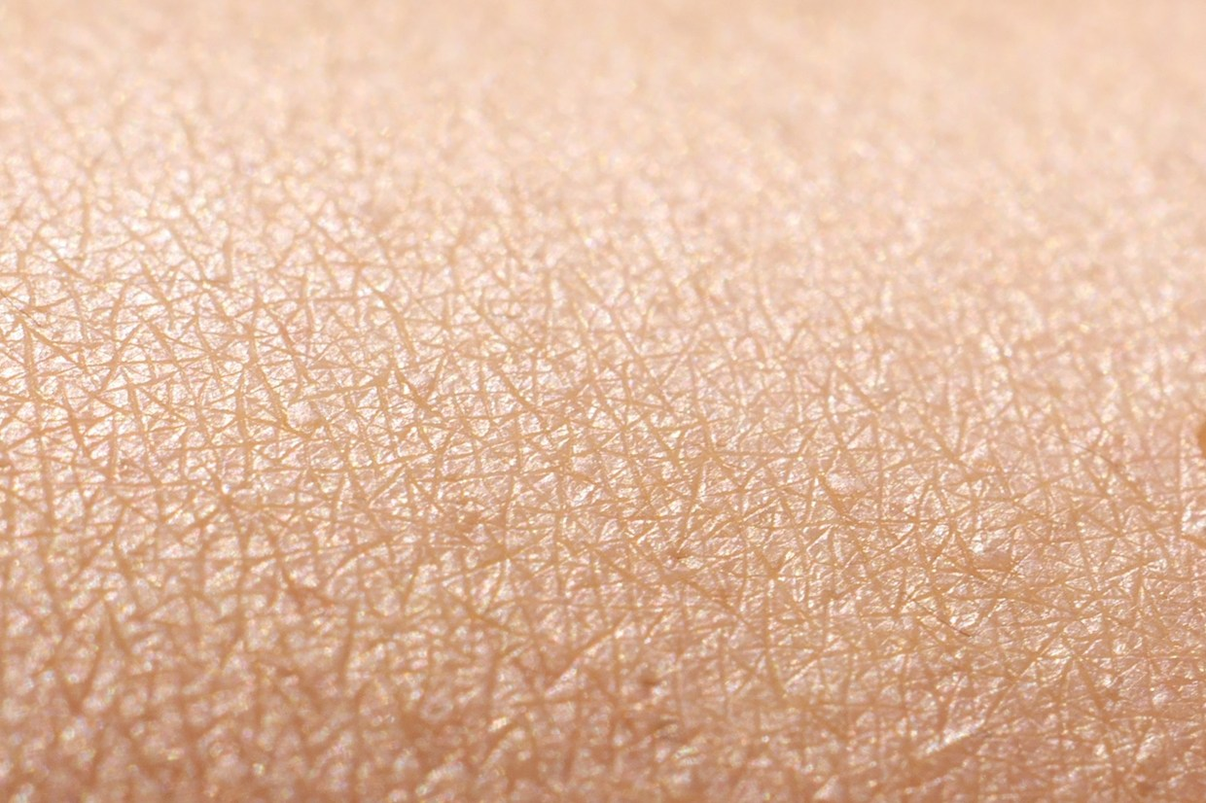
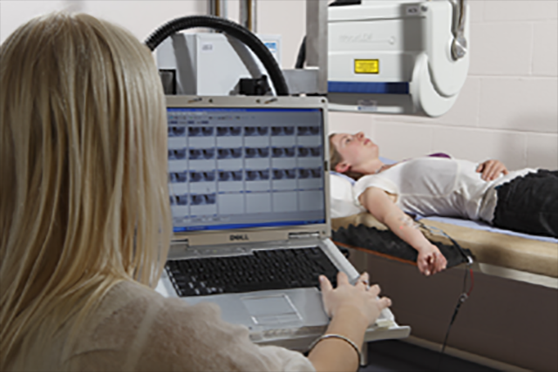
GCRF Workshop health@reading
Adrian Williams
Professor of Pharmaceutics and
Research Dean (Health)

Slide 18

health-related research activities
Notes:
So, our research in the area of Health is organised into 5 research divisions. However this does not give the complete picture of our work.
Recently, an audit of all the health-related work at Reading enabled us to capture a more comprehensive offering, which addresses many of the modern UK and Global concerns surrounding ‘Health’. This inclusive coverage of what we term the ‘healthcare continuum’ puts us at a distinct advantage over medical institutions which concentrate on simply ‘treatment’. We have expertise in each area of the continuum and many of the interactions are interconnected.

Slide 19
UoR: Broad ranging health research projects
Across most areas of the University, e.g.
  Philosophy / Psychology / NHS on “pain”
  Henley Business School: big data for patient care pathways
  Climate modelling and food quality to health impacts
  Typography / information design for patients & carers
  Education – healthy lifestyles and second language acquisition
  Built environment: hospital ward design, green spaces
  Chemistry: stents, fibrils etc.
  Global development: climate – food – nutrition – health

Slide 20

Examples of health-related research projects
Book sharing
Peter Cooper and Lynn Murray, PCLS
The Mikhulu Trust is working to promote the health, wellbeing and development of children living in conditions of adversity by encouraging child cognitive and socio-emotional development.
Autism in India
Bishma Chakrabarti PCLS
Developing culturally appropriate apps and interventions

Slide 21

Vaccines and transmissible diseases
Improved vaccine candidates for Influenza, Polio
  and Foot and Mouth Disease.
Rapid diagnostics
  And smartphone readable
Mosquitos
Repellents

Slide 22
And “developed” country conditions becoming prevalent in developing countries / regions
Obesity
Cardiovascular diseases
Diabetes
  And genetic predisposition / risk factors for the above
Public health - economics
Epidemiology - some linked to nutrition in FNS
Healthy buildings – Built environment
Health messaging – typography
Anti snake-venom – pharmacy (cardiovascular)
some activity in:

Slide 23

Are you GCRF ready?
Research Services
Dr Elisavet Kitou and Dr Tristan Eagling

Slide 24

Outline of the day
Eloise Mellor RCUK
Pitch presentations
Lunch (1L08)
Jennie Dodson UKCDS
Pitch presentations
Formal Networking Session (1L08)
Case Studies

Slide 25
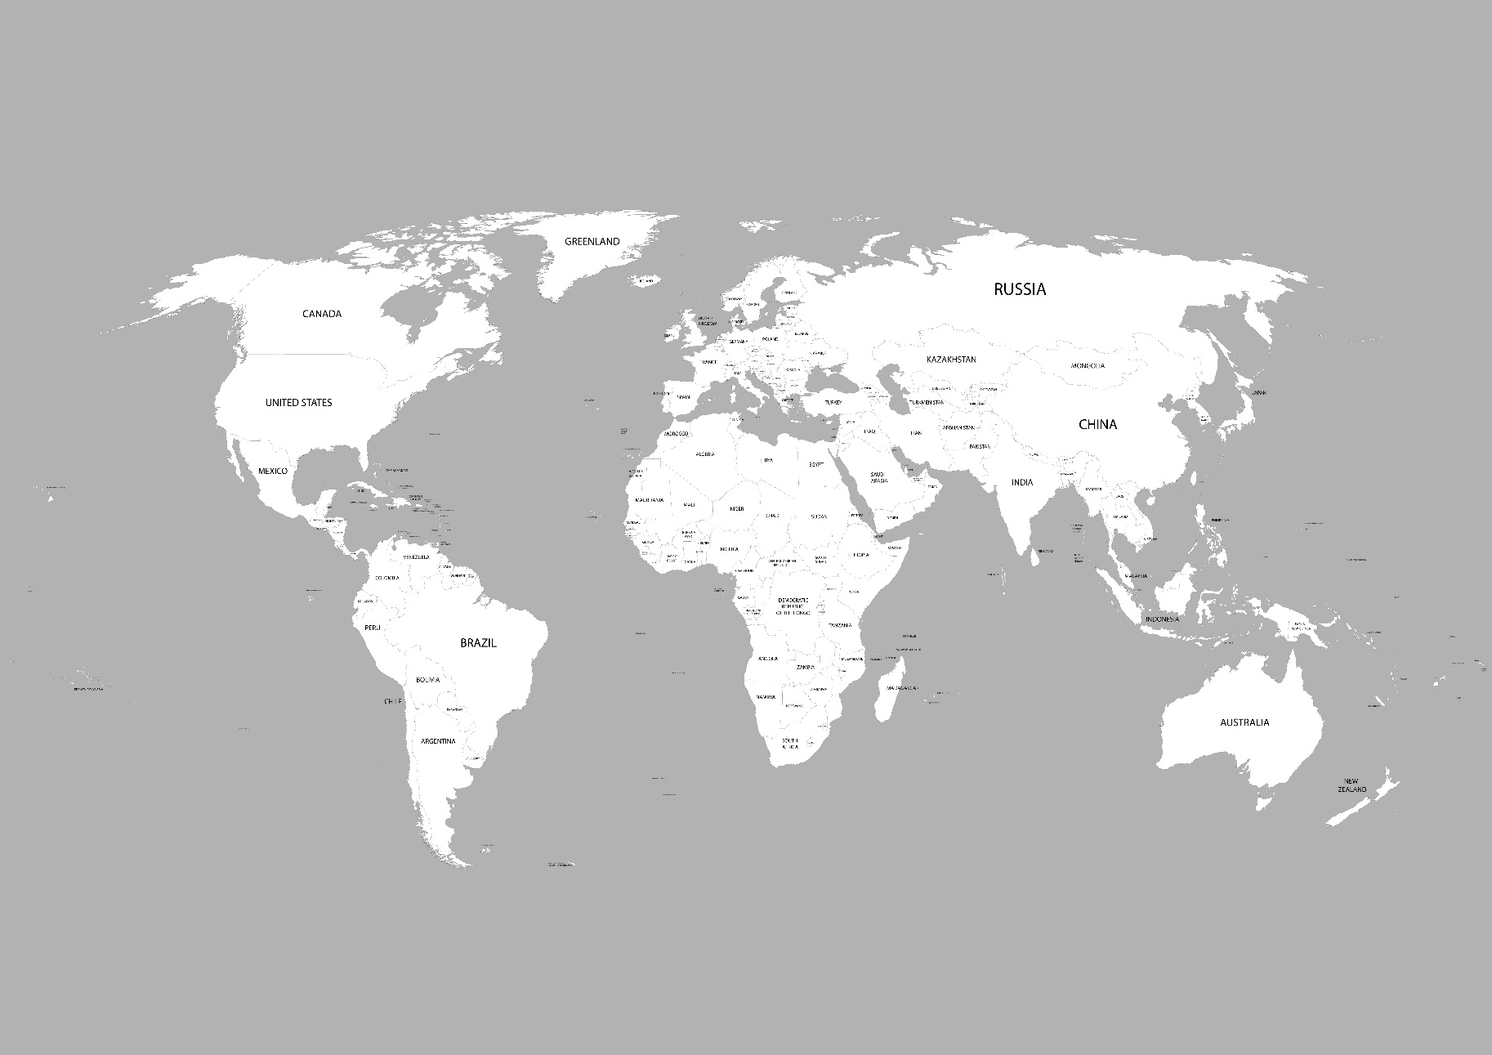
Outline of the day
Eloise Mellor RCUK
Pitch presentations
Lunch
UKCDS
Pitch presentations
Instructions for informal networking session
Case Studies
MAP

Slide 26
How to be prepared
Think about your research with regards to DAC countries
Get in touch with all your contacts
Set up new contacts
Discuss what you can work on together
Get information about LMICs institutional requirements
Prepare draft proposals – even if just a page

Slide 27
Research services
Who we are
What we do
How we can help

